Slide 1
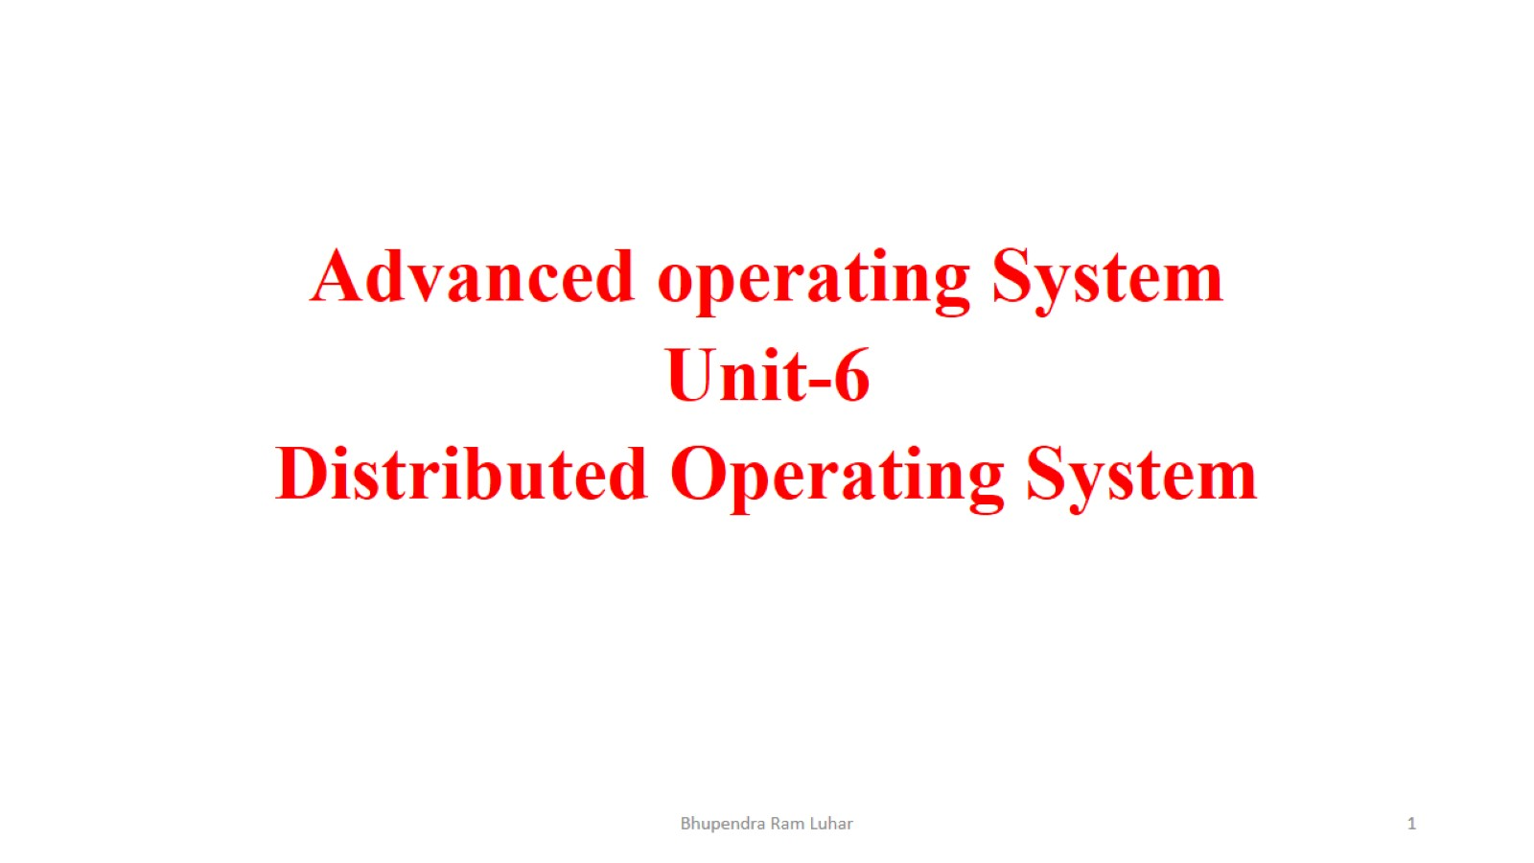

Slide 2
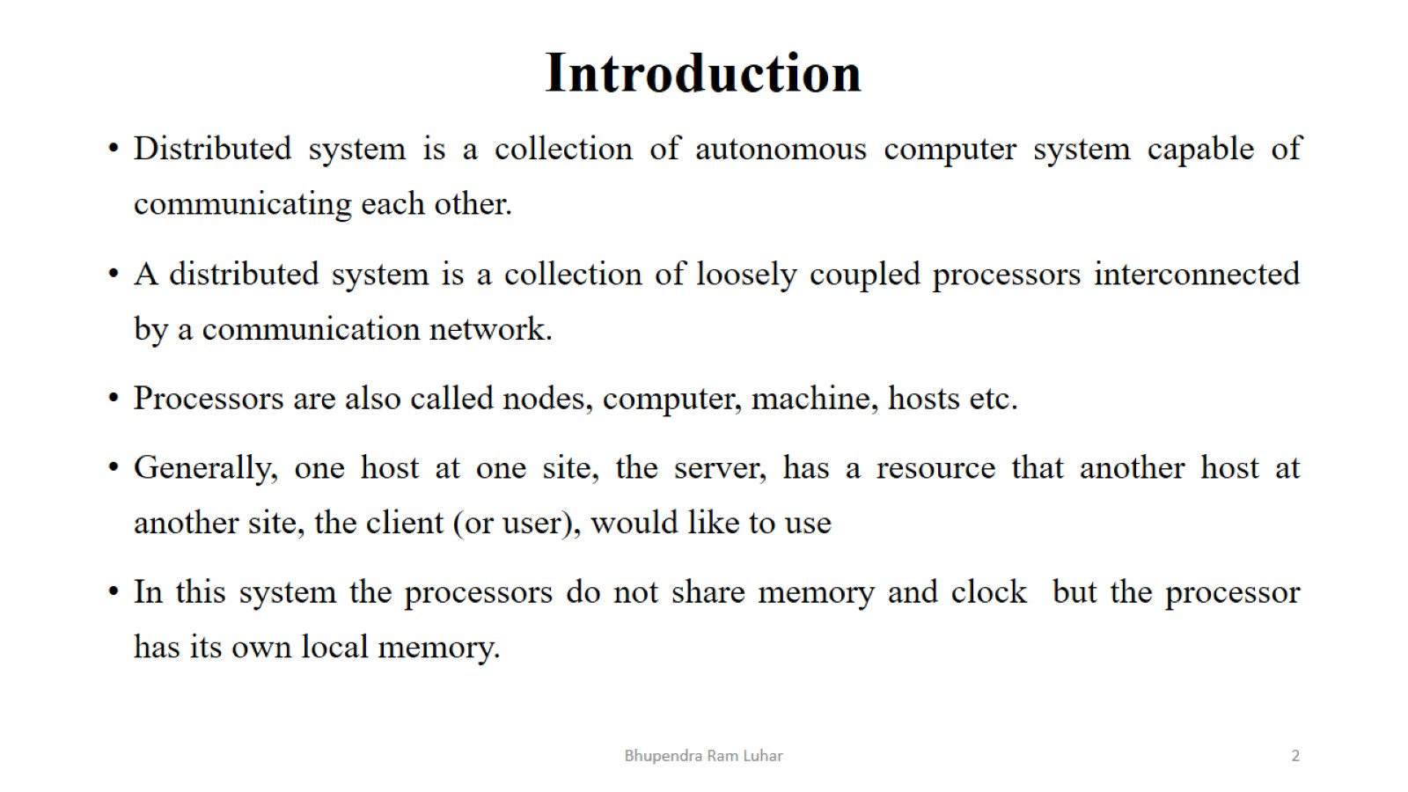
Introduction

Slide 3
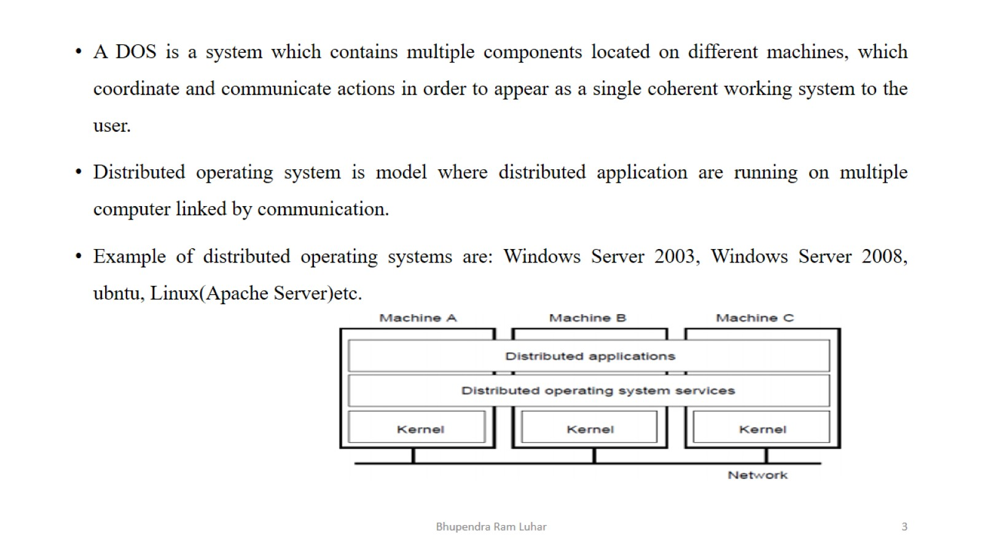

Slide 4
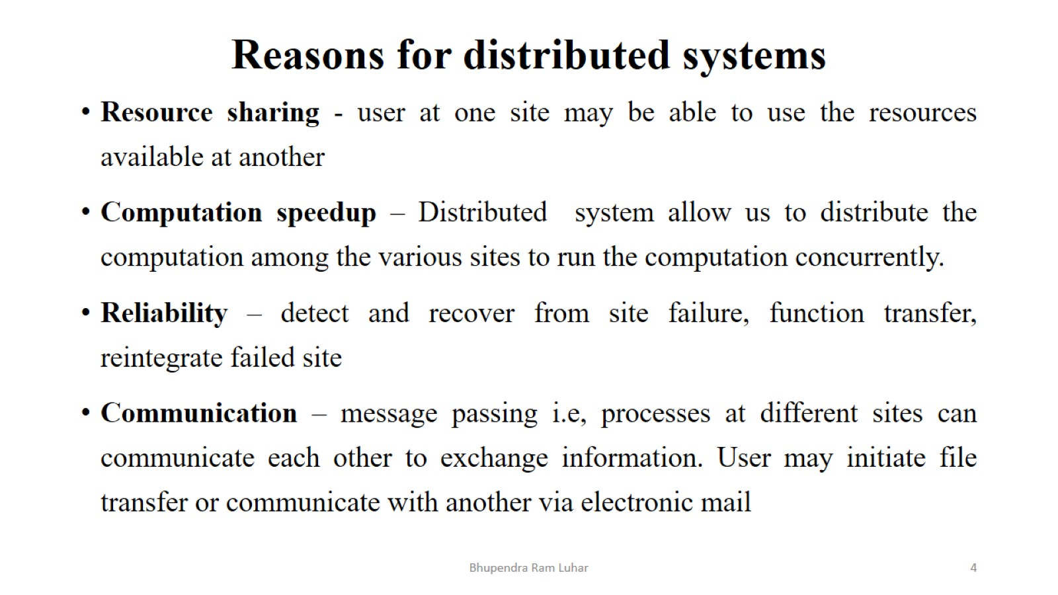
Reasons for distributed systems

Slide 5
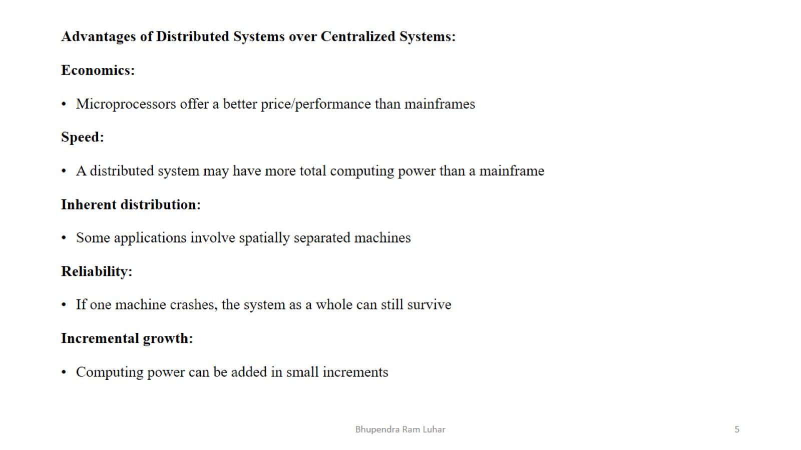

Slide 6
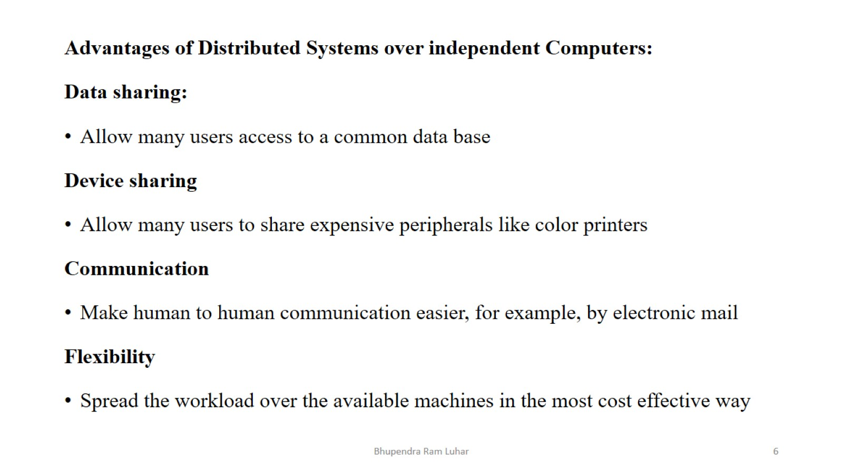

Slide 7
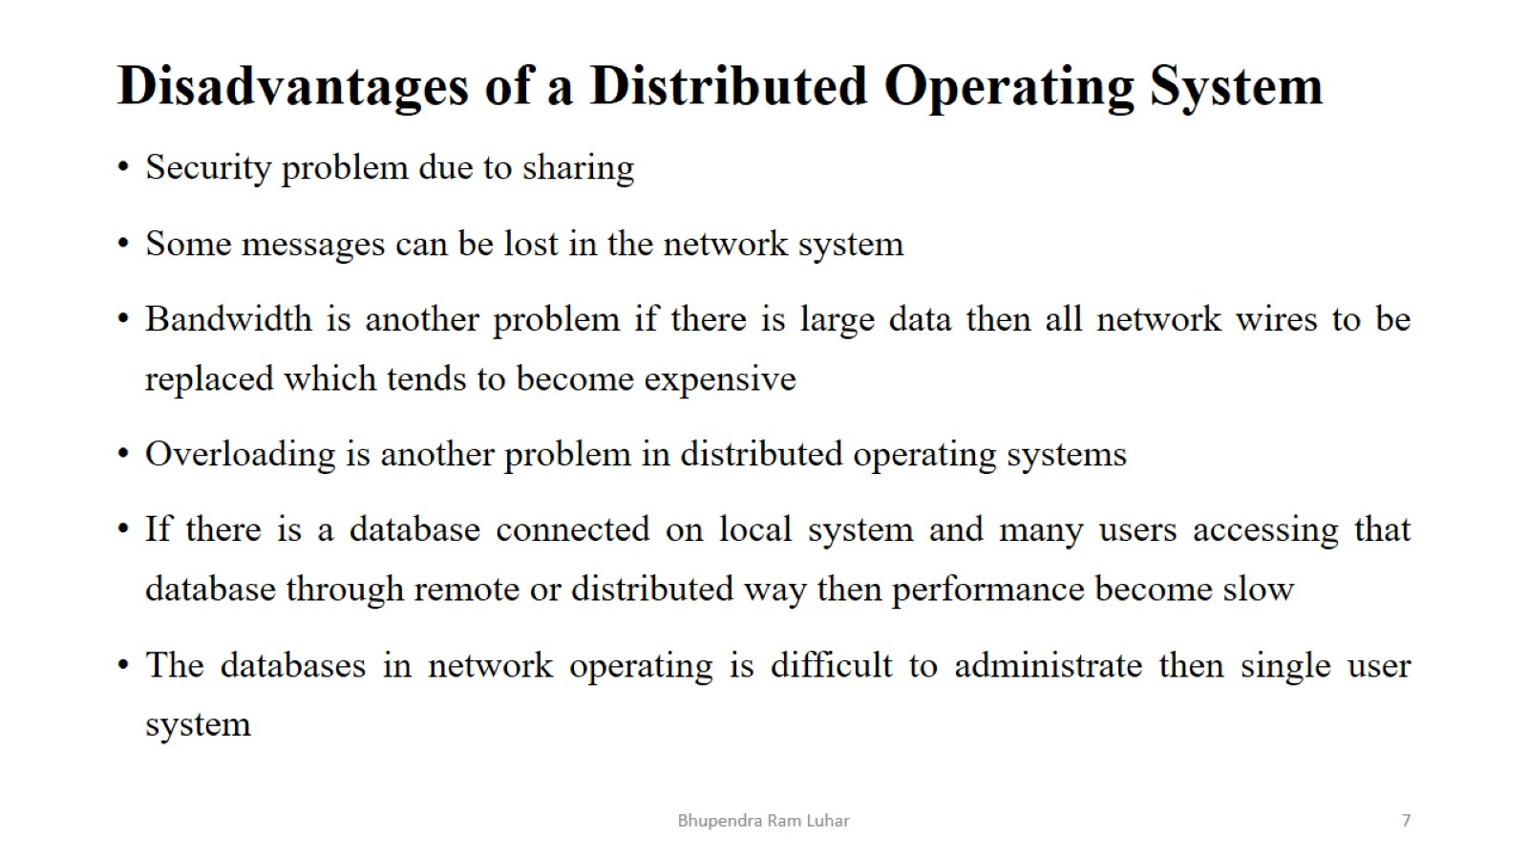
Disadvantages of a Distributed Operating System

Slide 8
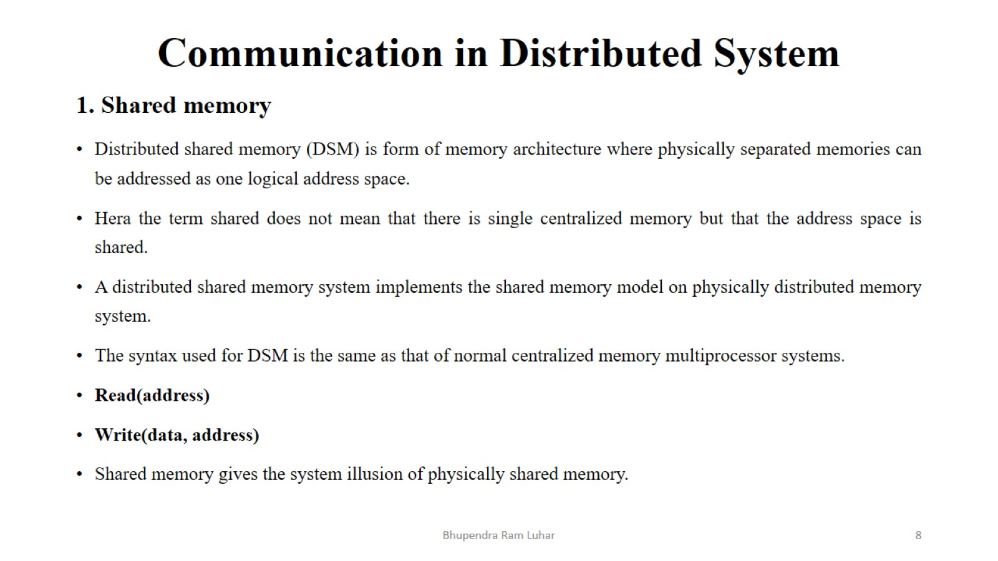
Communication in Distributed System

Slide 9
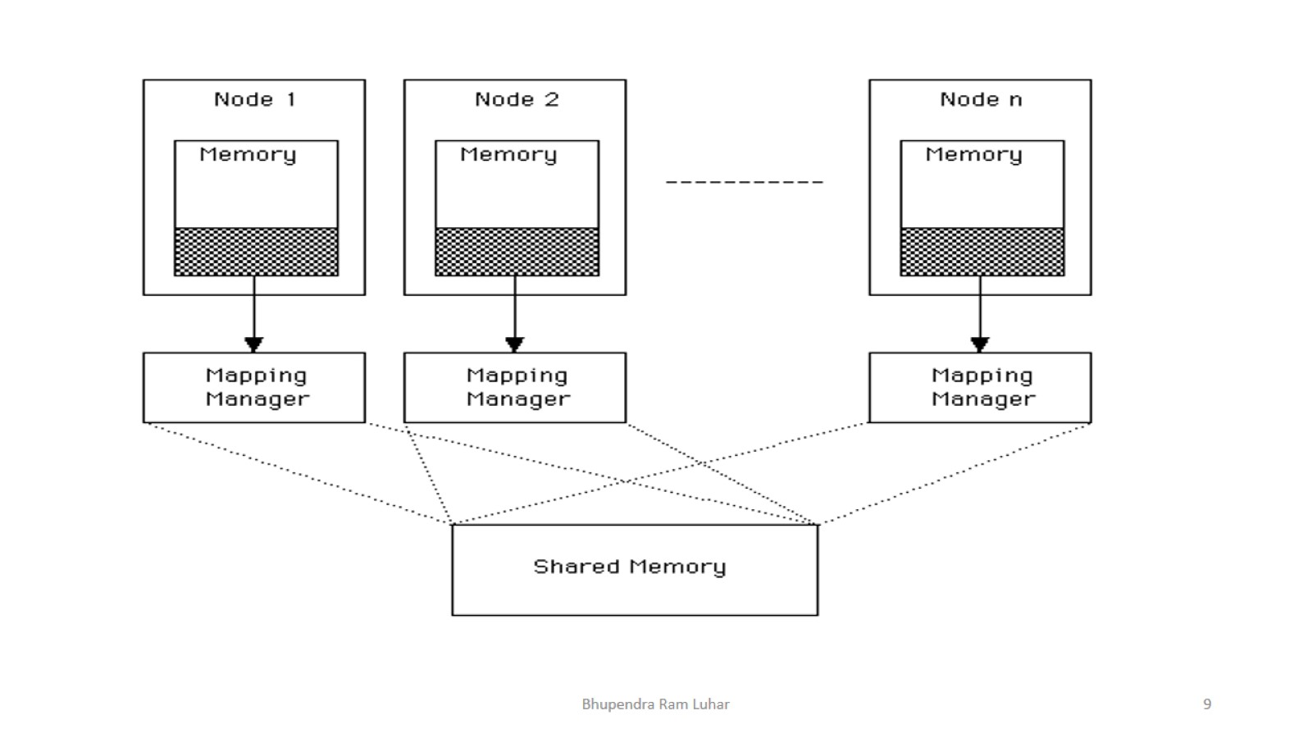

Slide 10
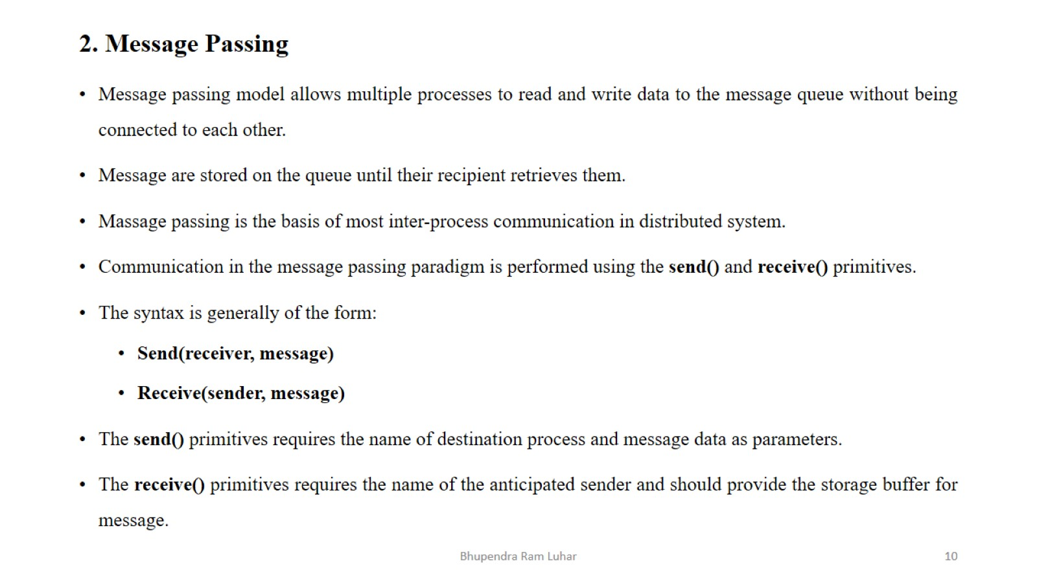

Slide 11
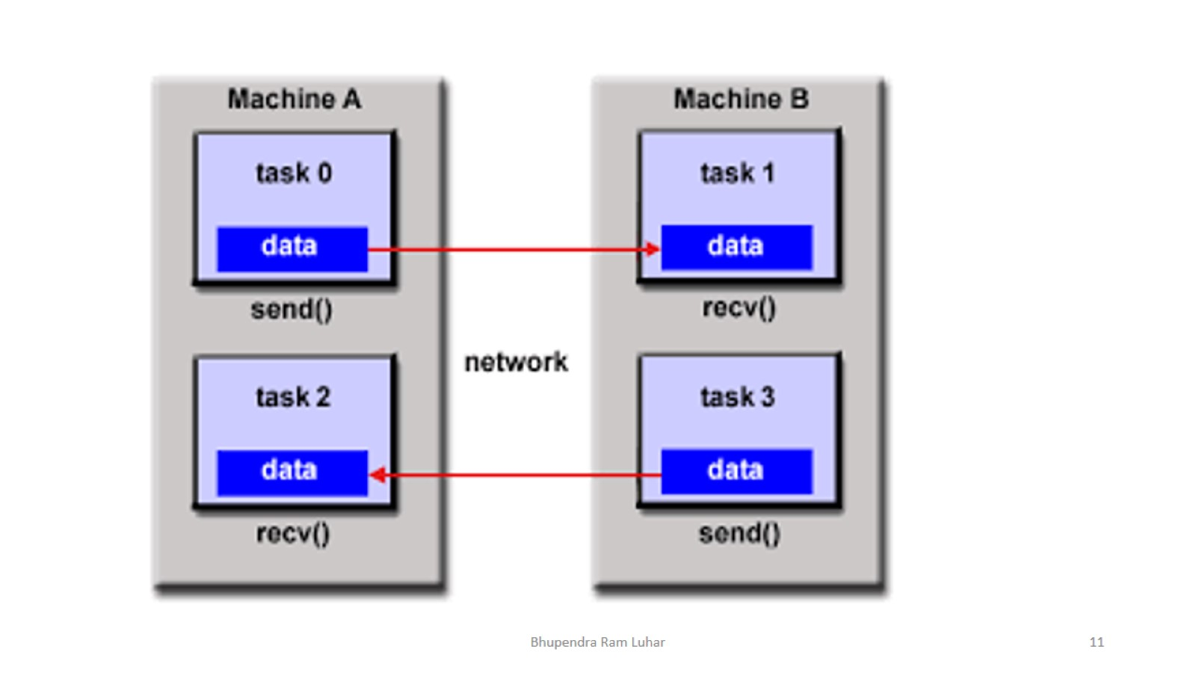

Slide 12
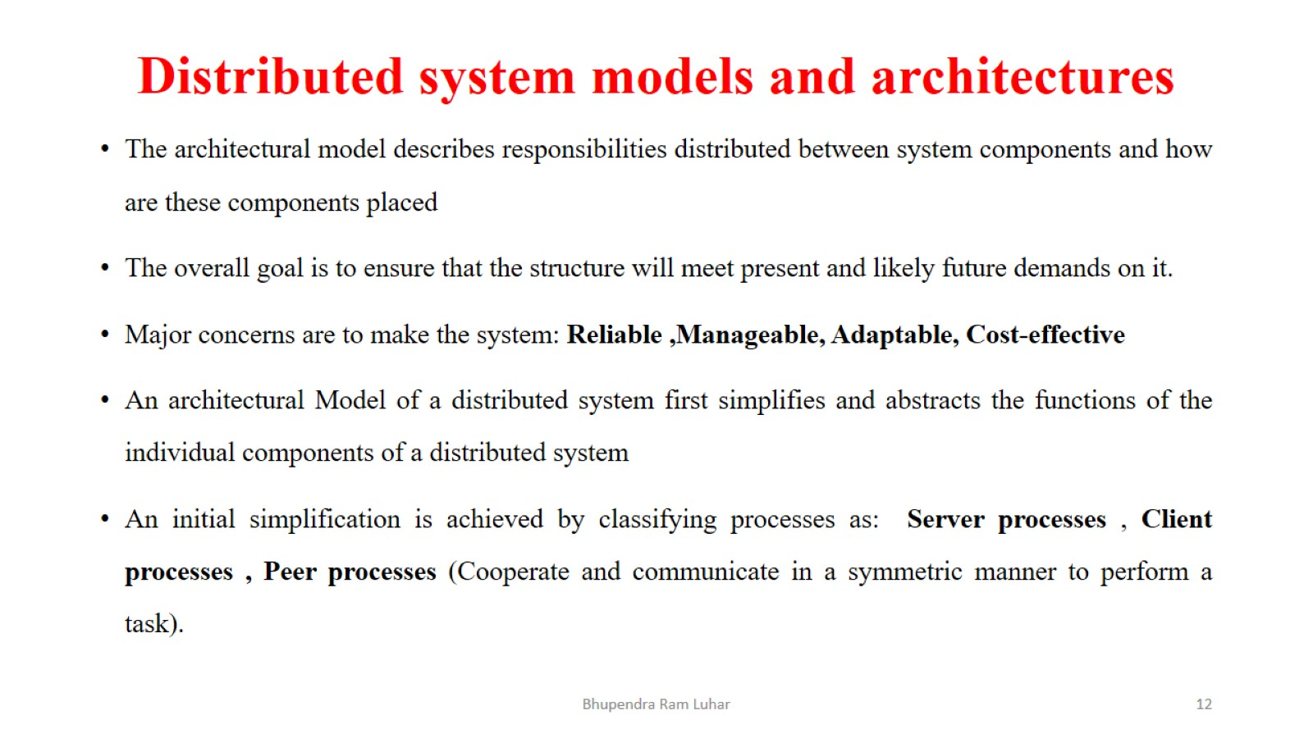
Distributed system models and architectures

Slide 13
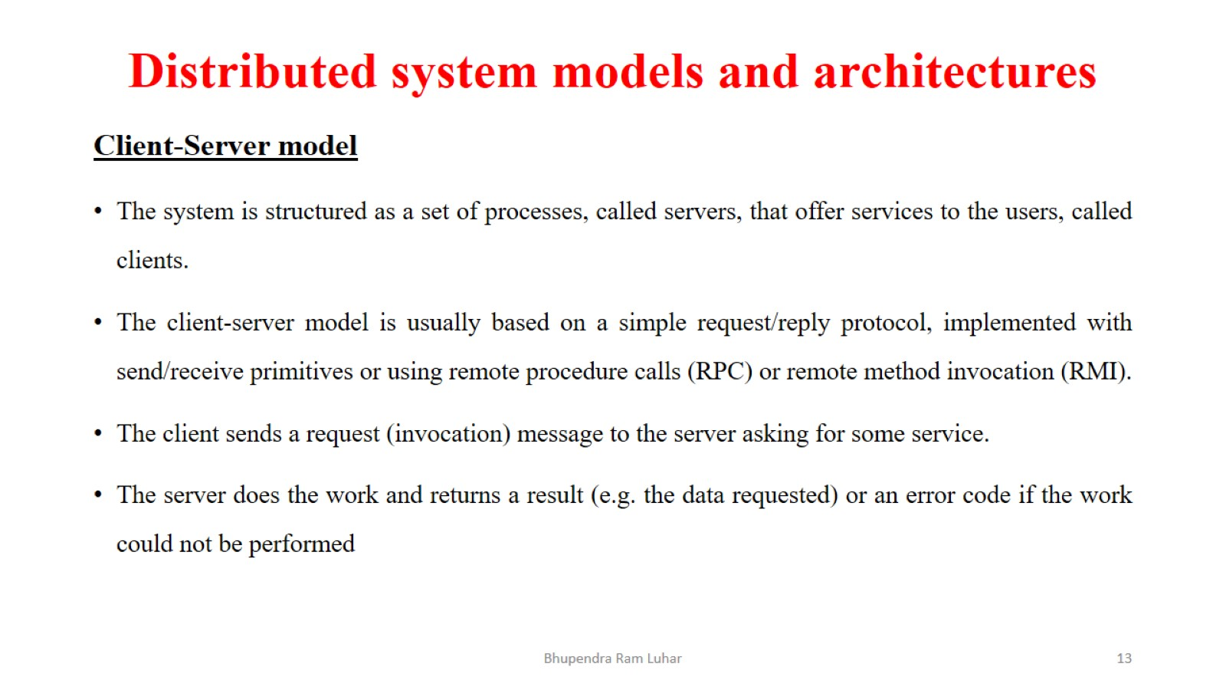
Distributed system models and architectures

Slide 14
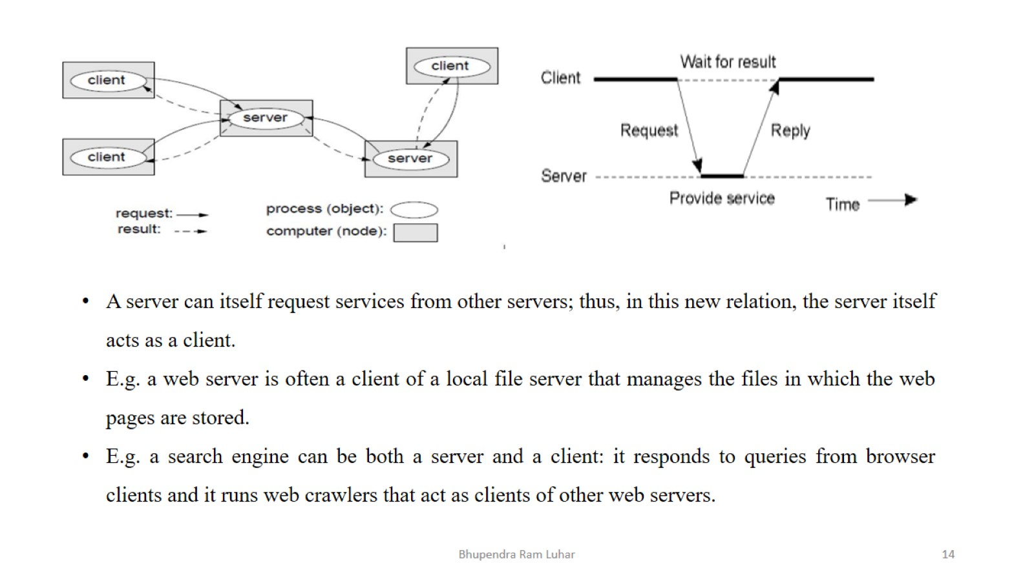

Slide 15
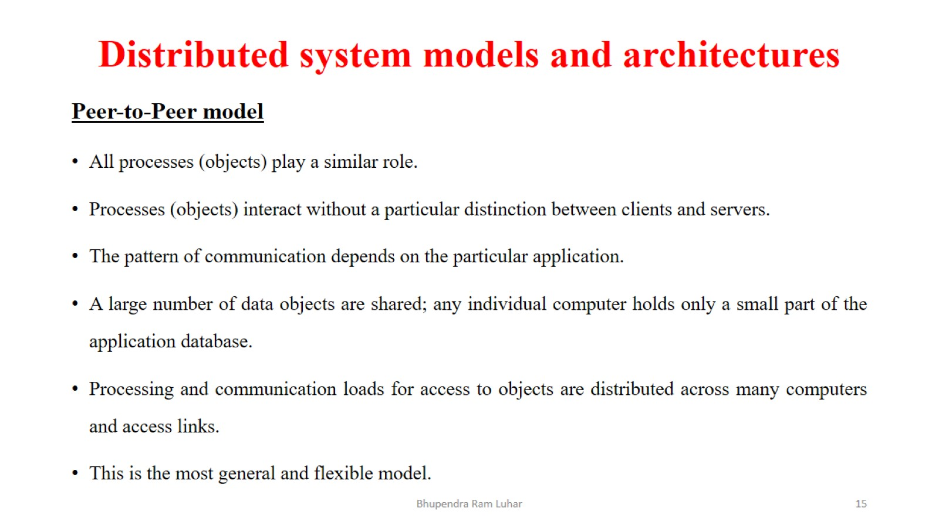
Distributed system models and architectures

Slide 16
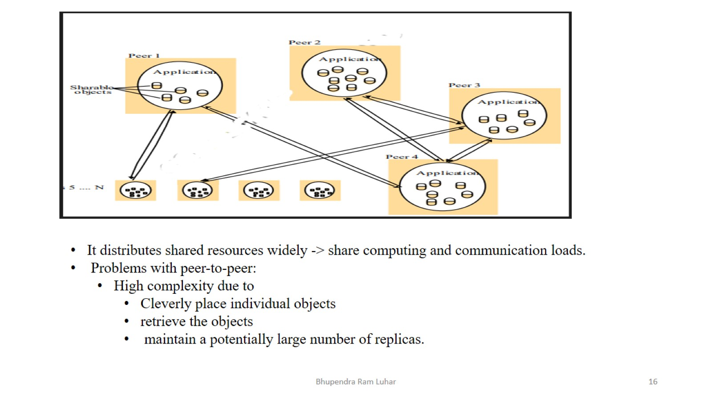

Slide 17
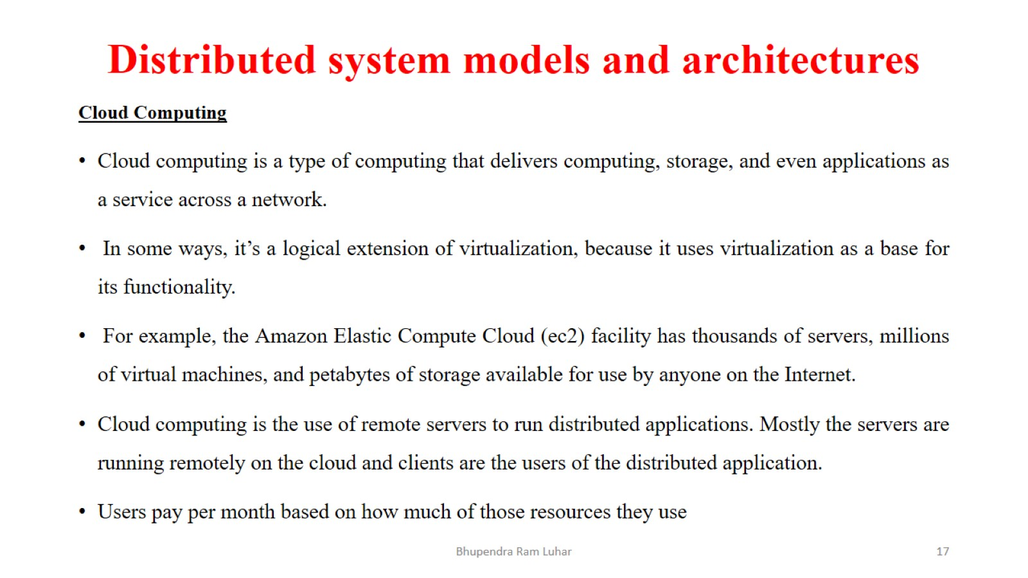
Distributed system models and architectures

Slide 18
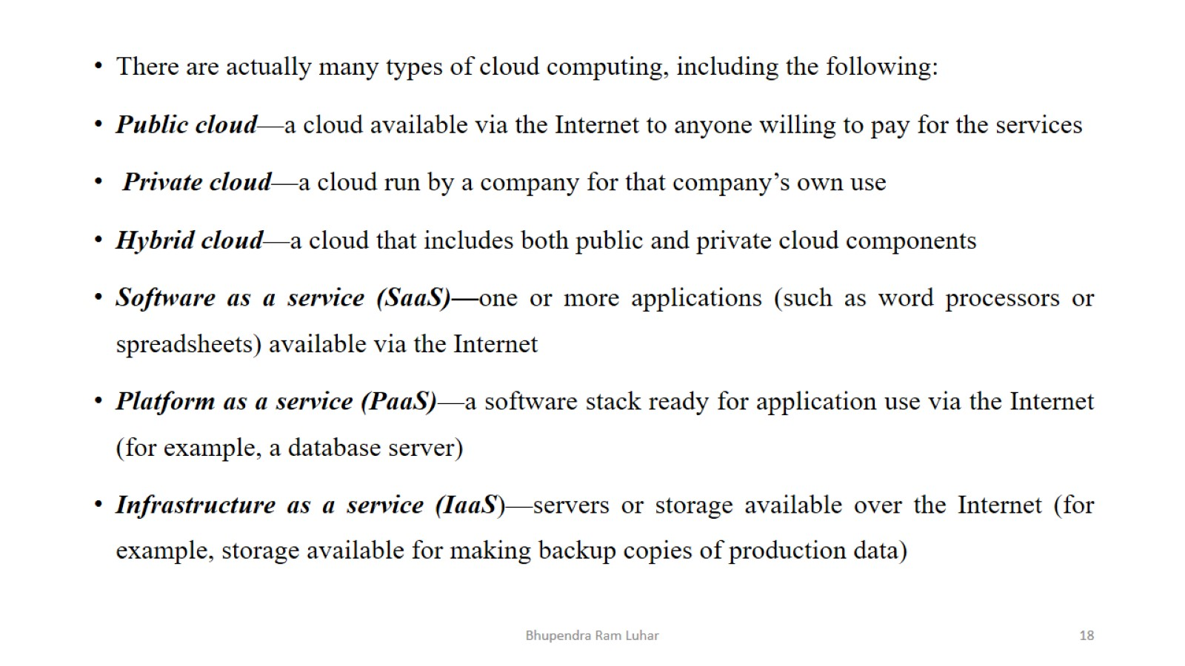

Slide 19
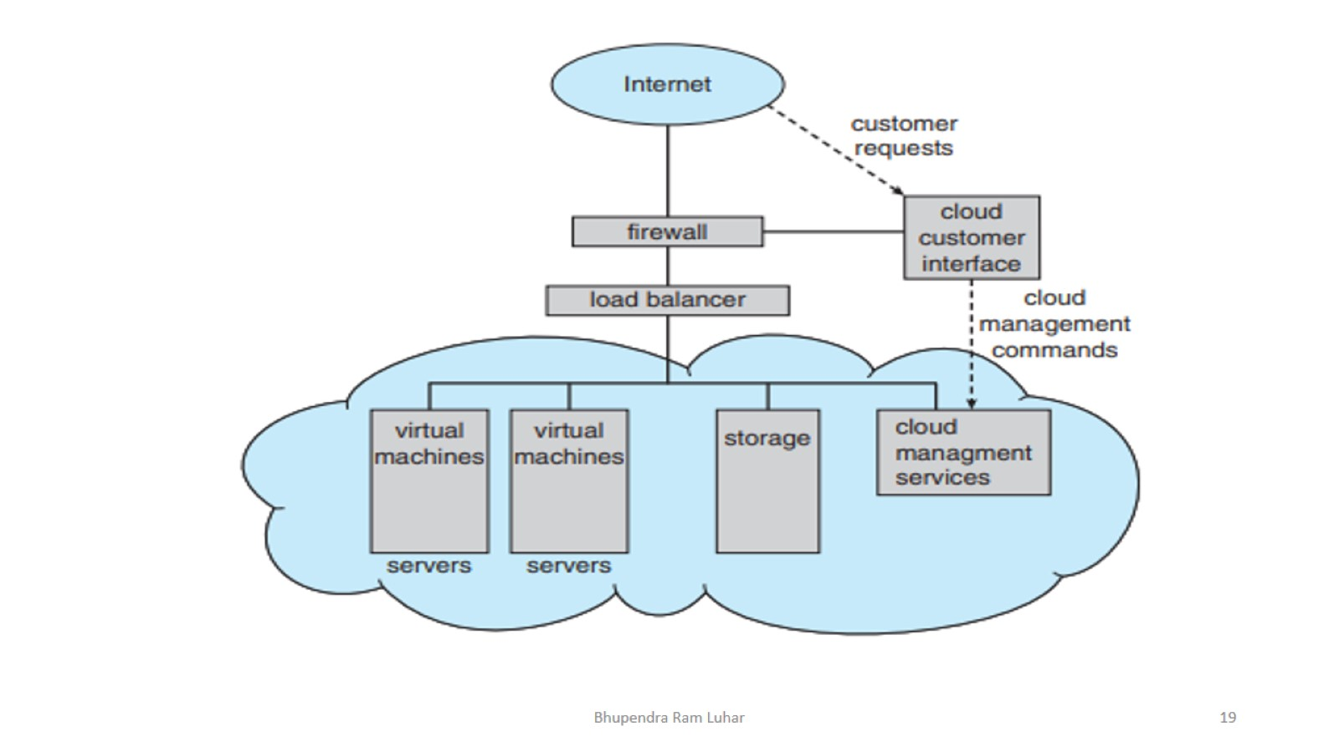

Slide 20
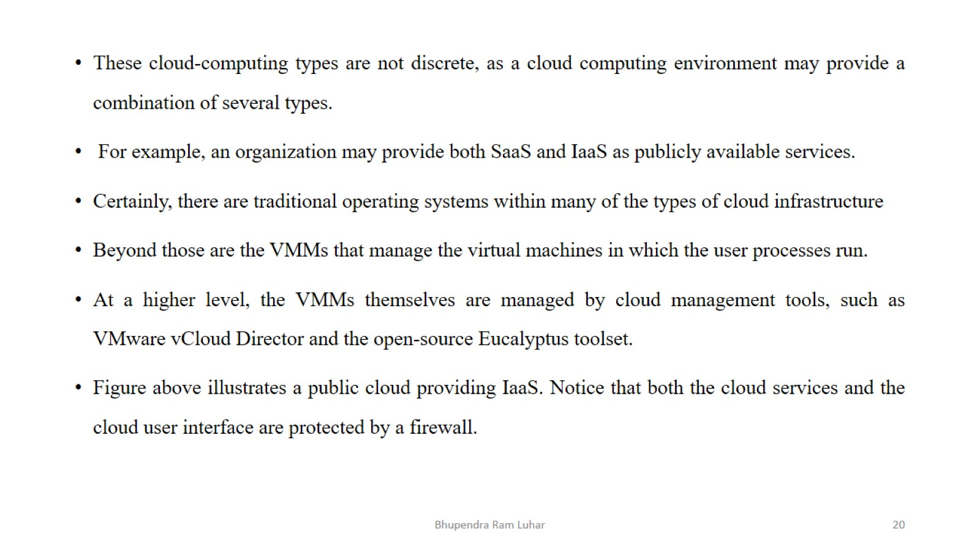

Slide 21
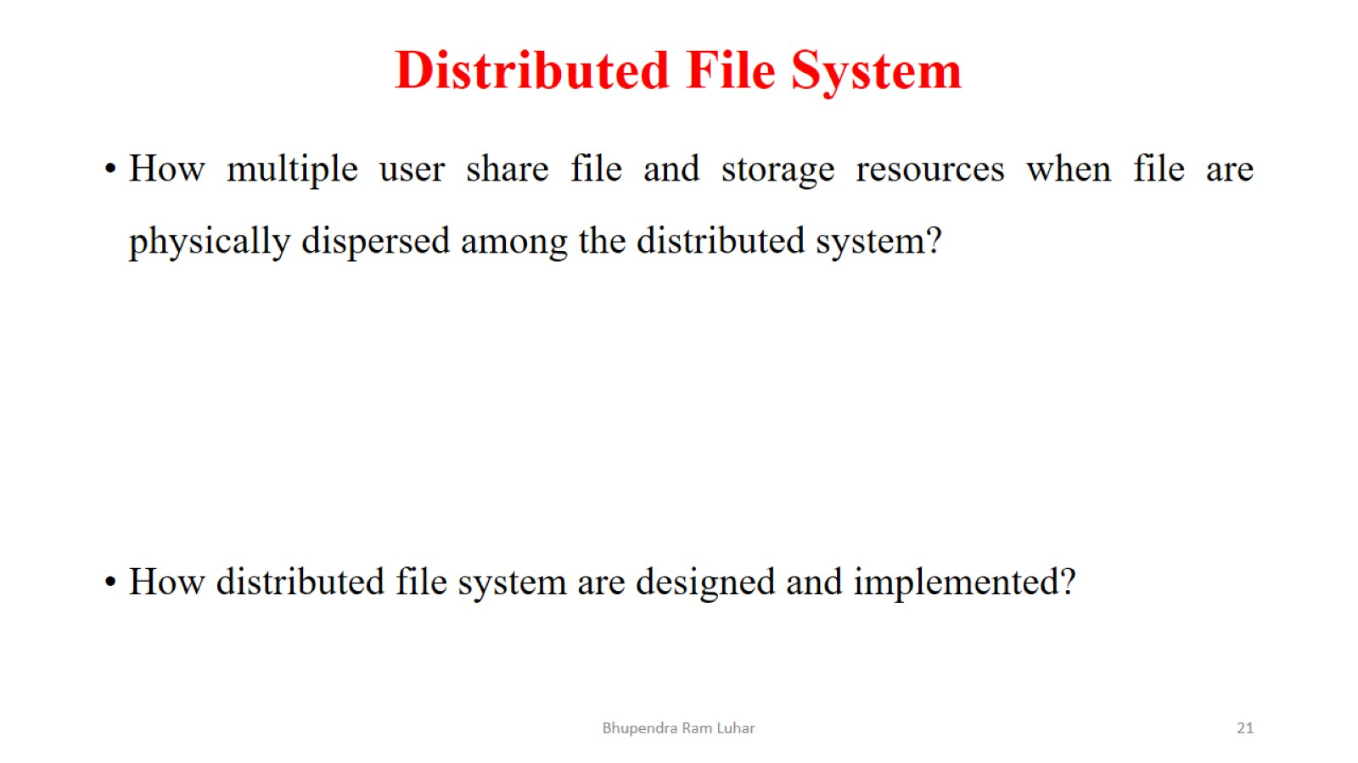
Distributed File System

Slide 22
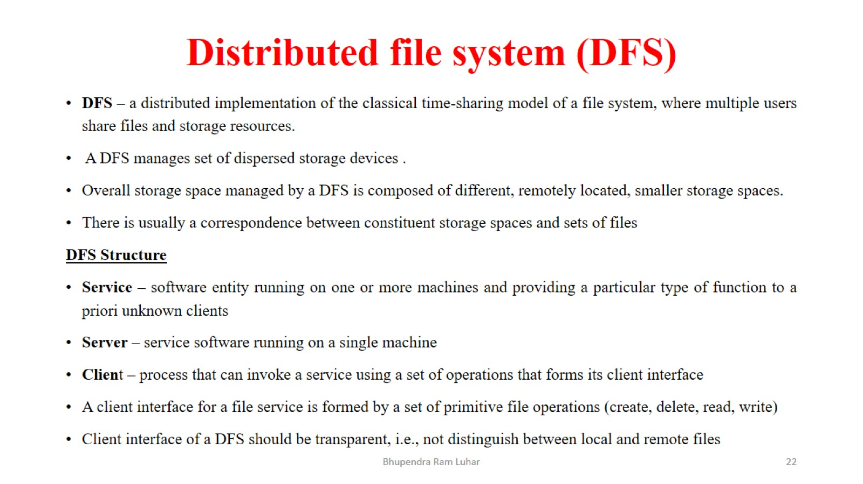
Distributed file system (DFS)

Slide 23
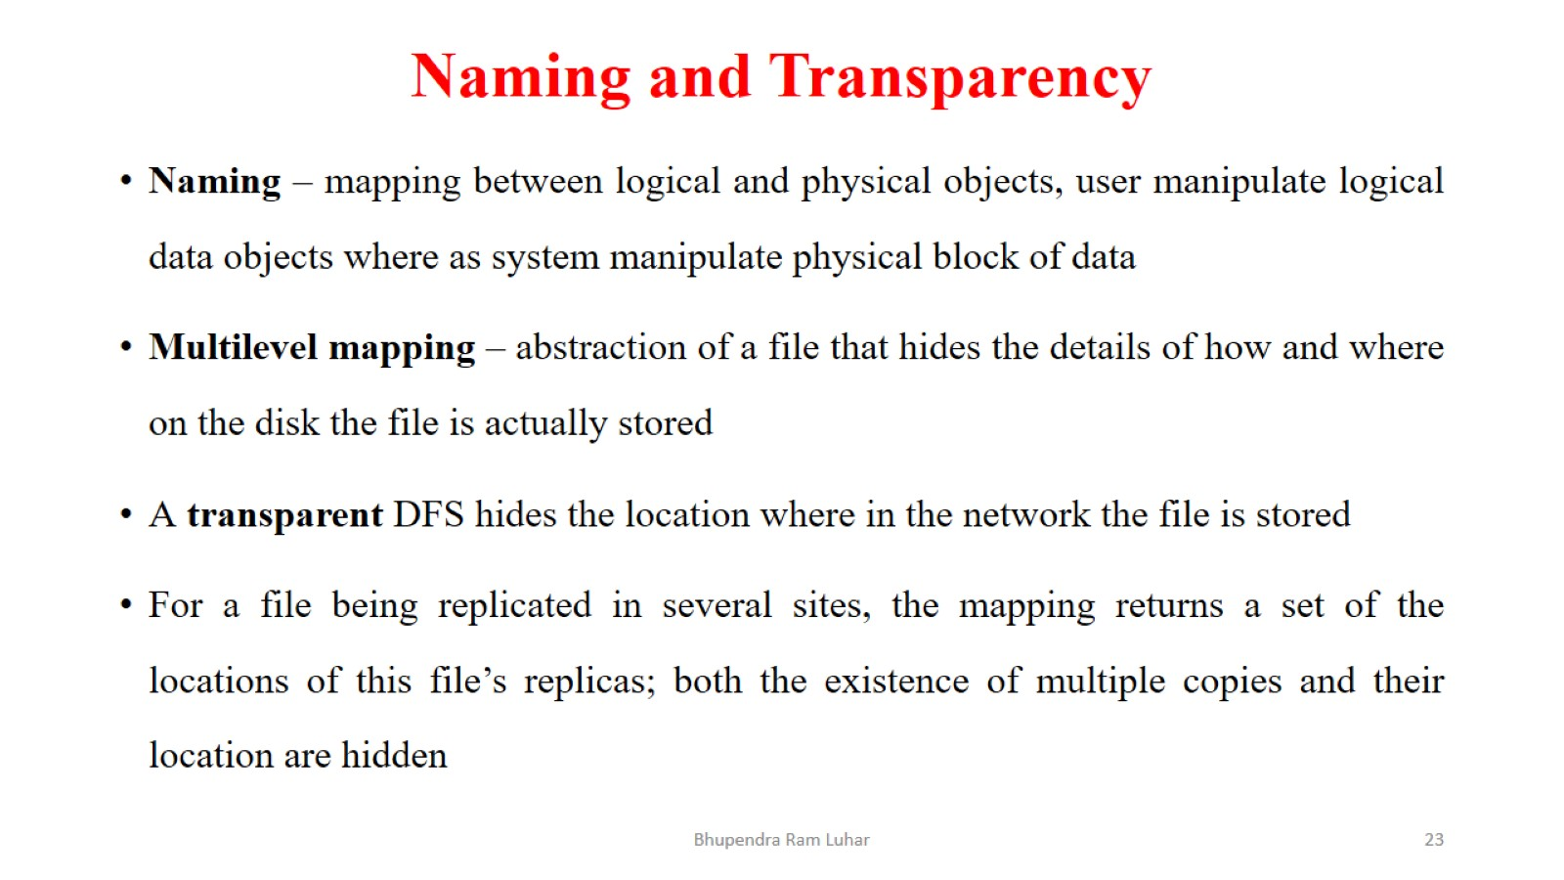
Naming and Transparency

Slide 24
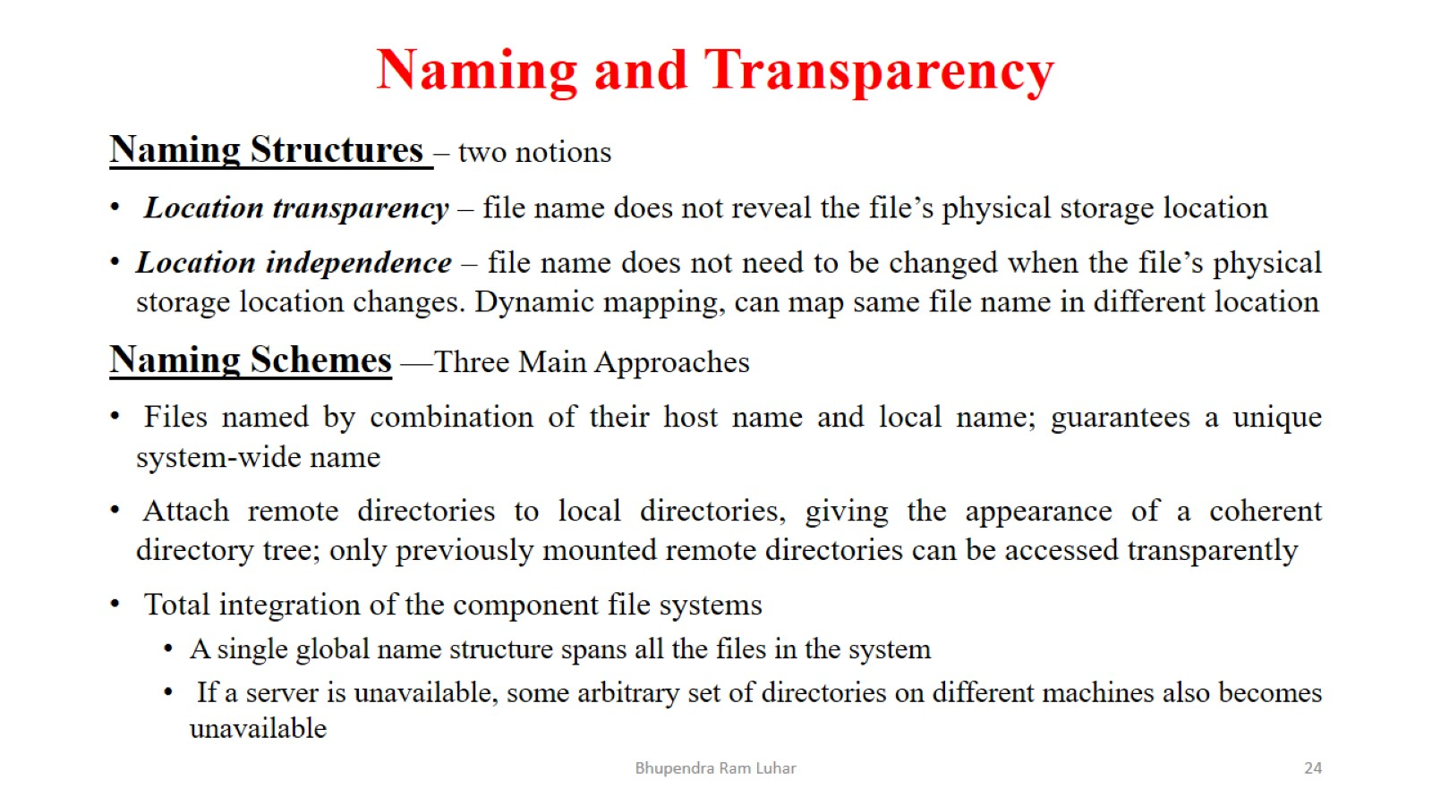
Naming and Transparency

Slide 25
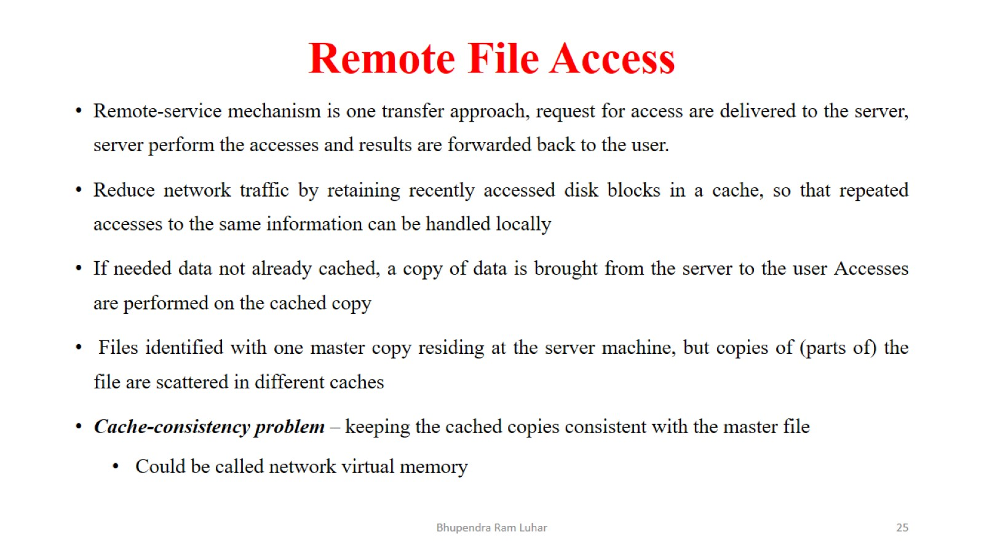
Remote File Access

Slide 26
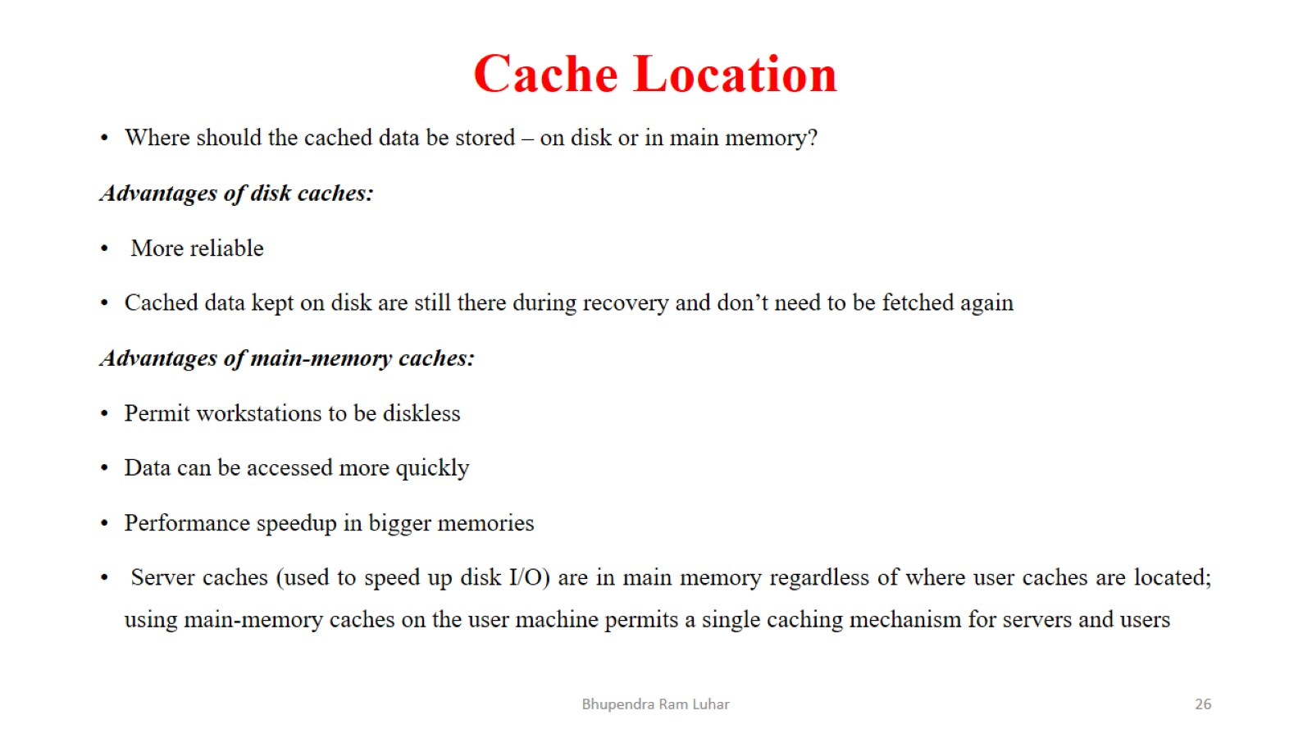
Cache Location

Slide 27
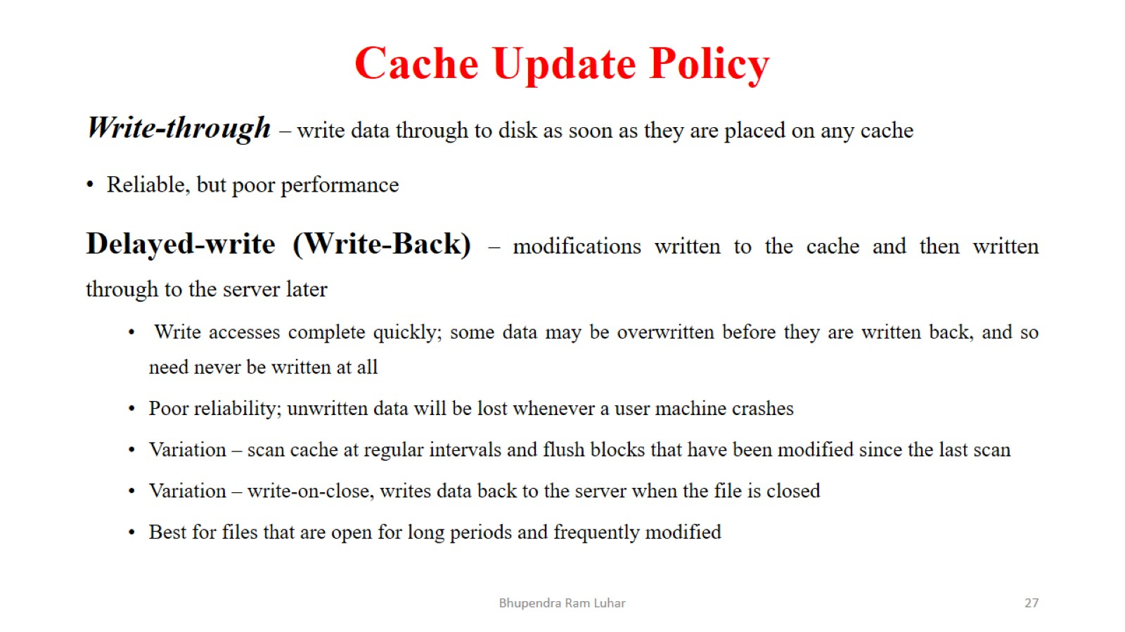
Cache Update Policy

Slide 28
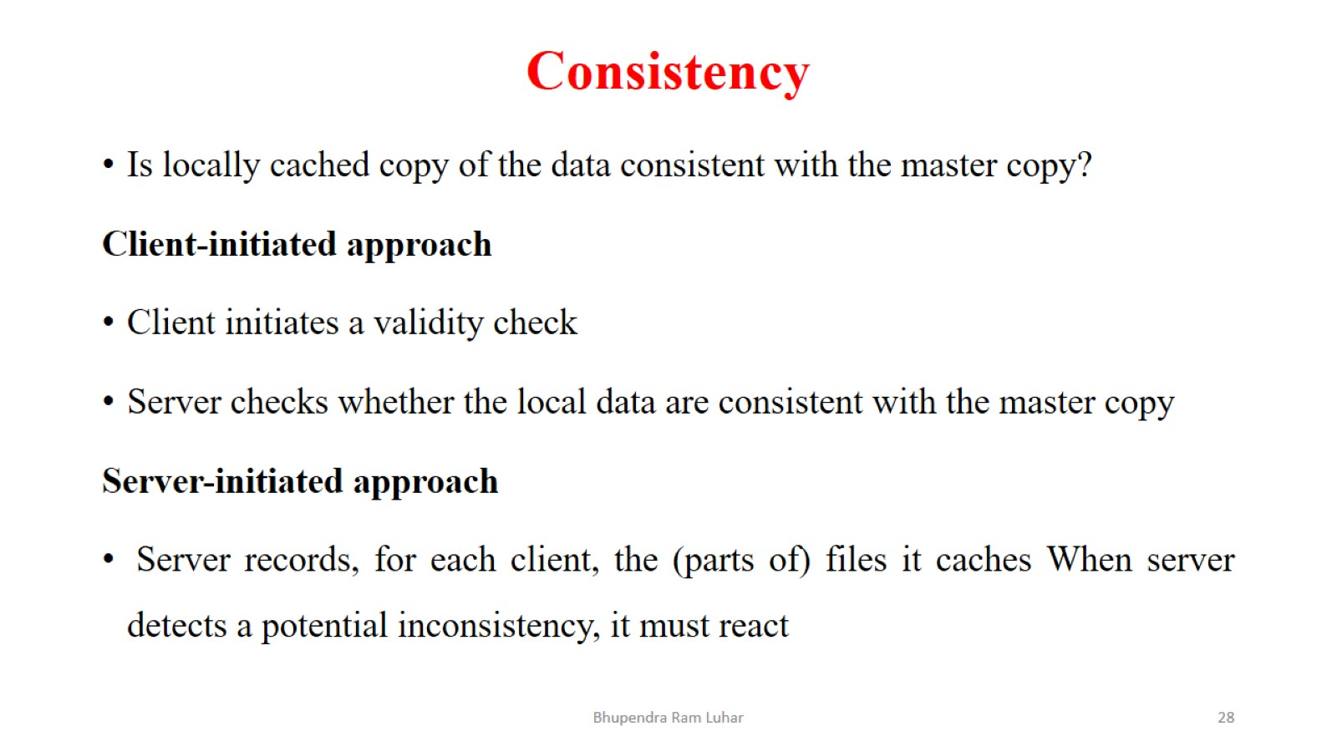
Consistency

Slide 29
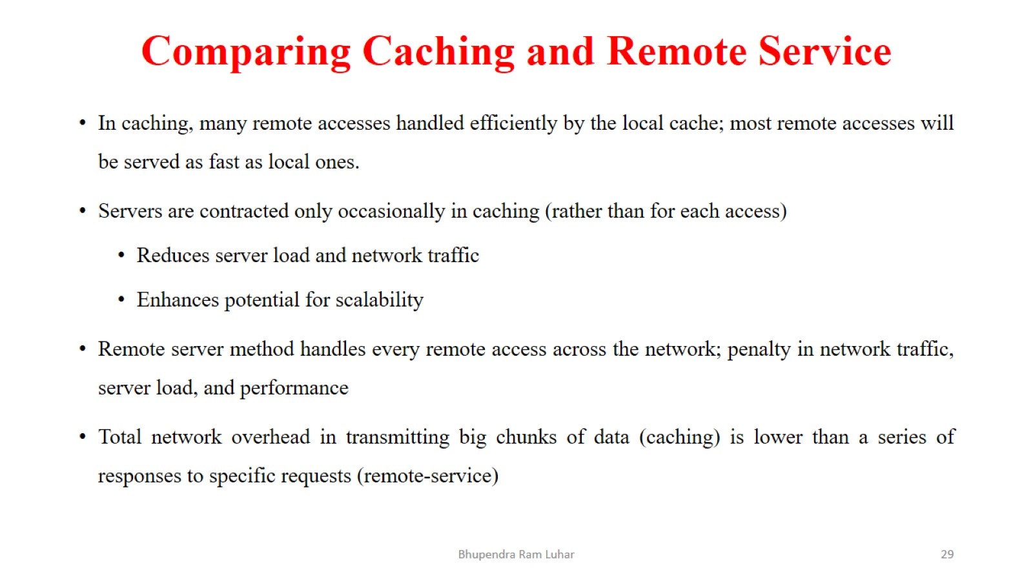
Comparing Caching and Remote Service

Slide 30
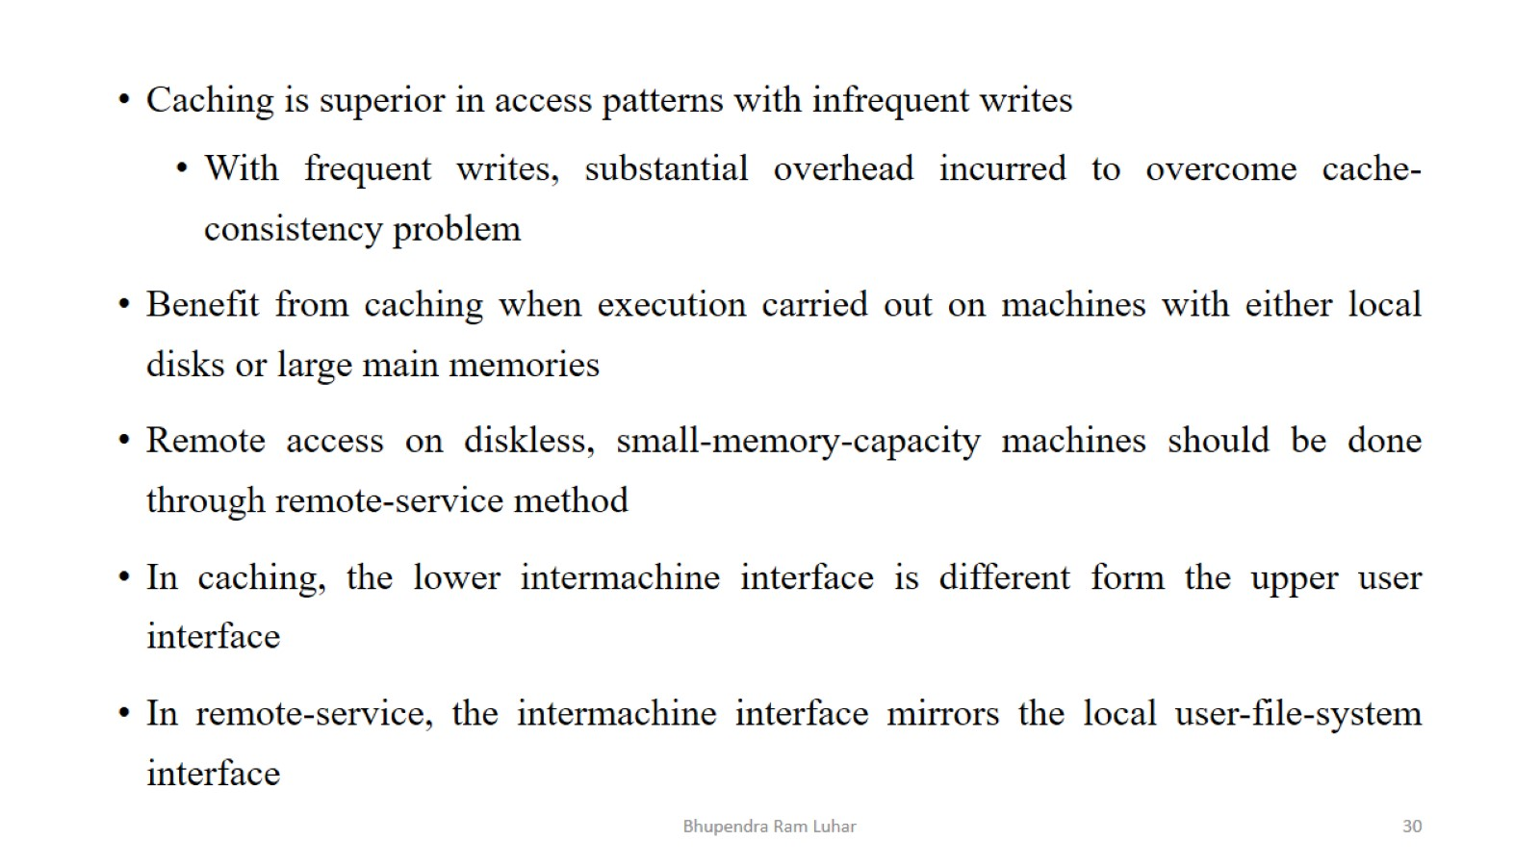

Slide 31
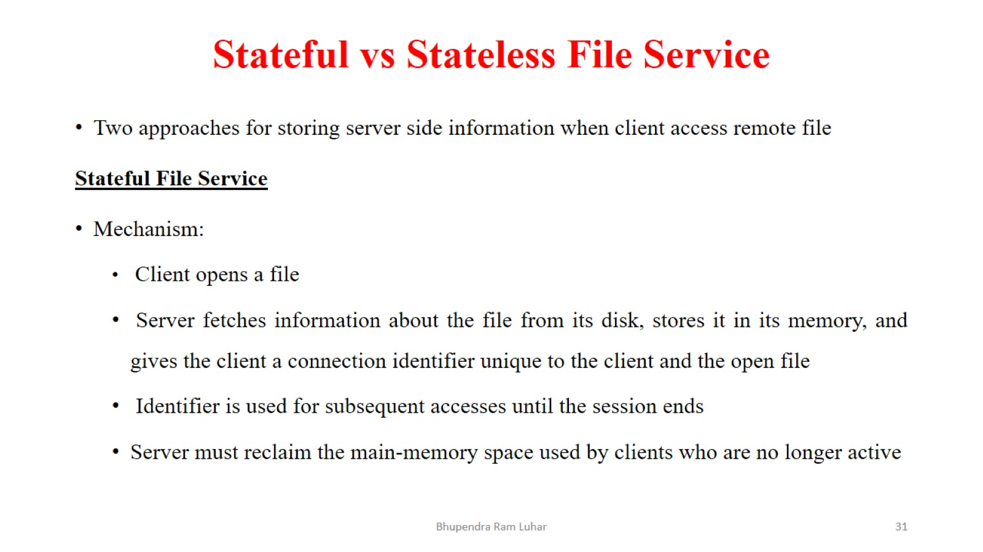
Stateful vs Stateless File Service

Slide 32
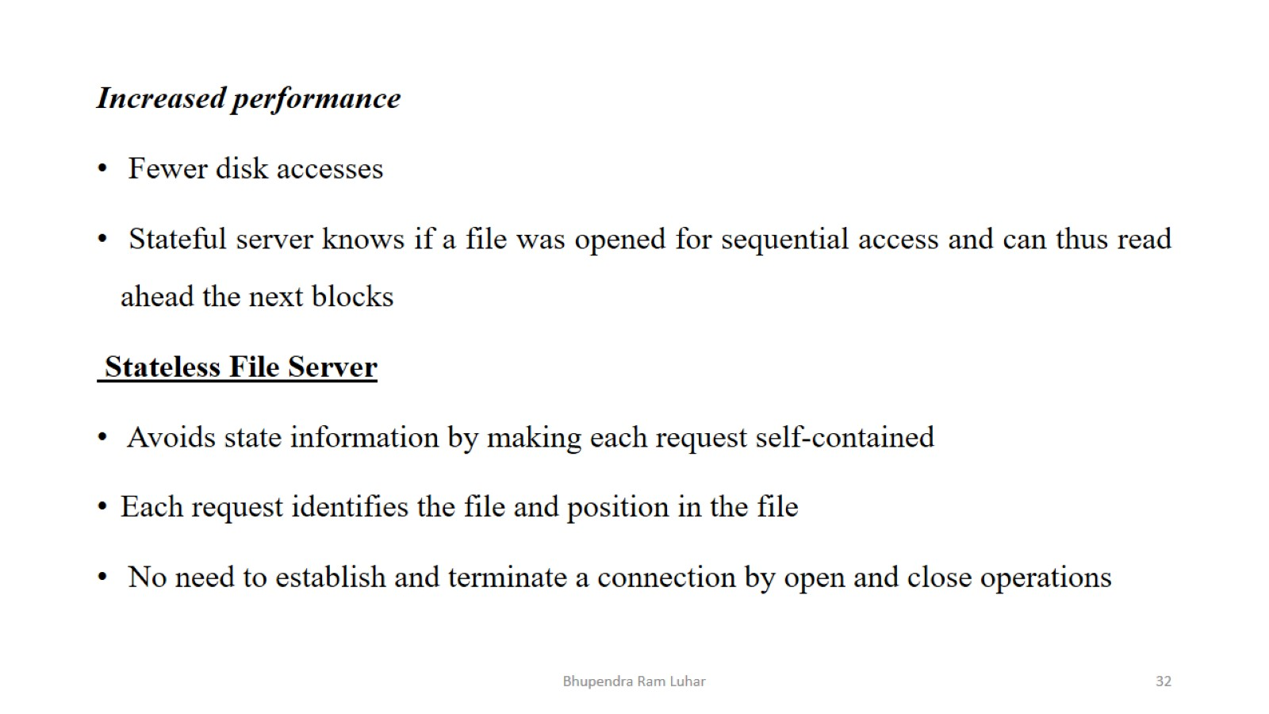

Slide 33
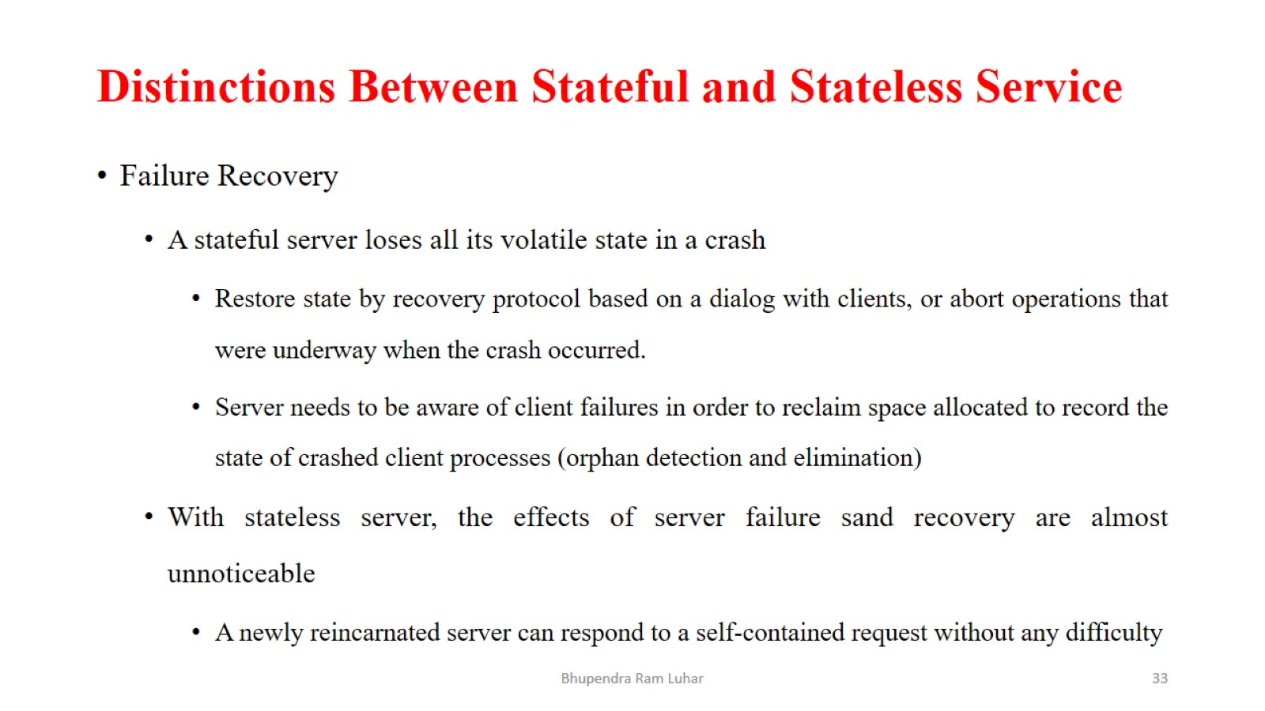
Distinctions Between Stateful and Stateless Service

Slide 34
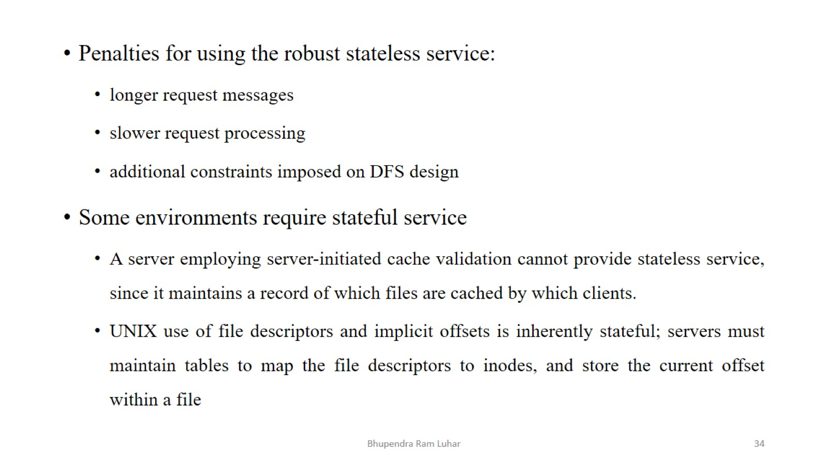

Slide 35
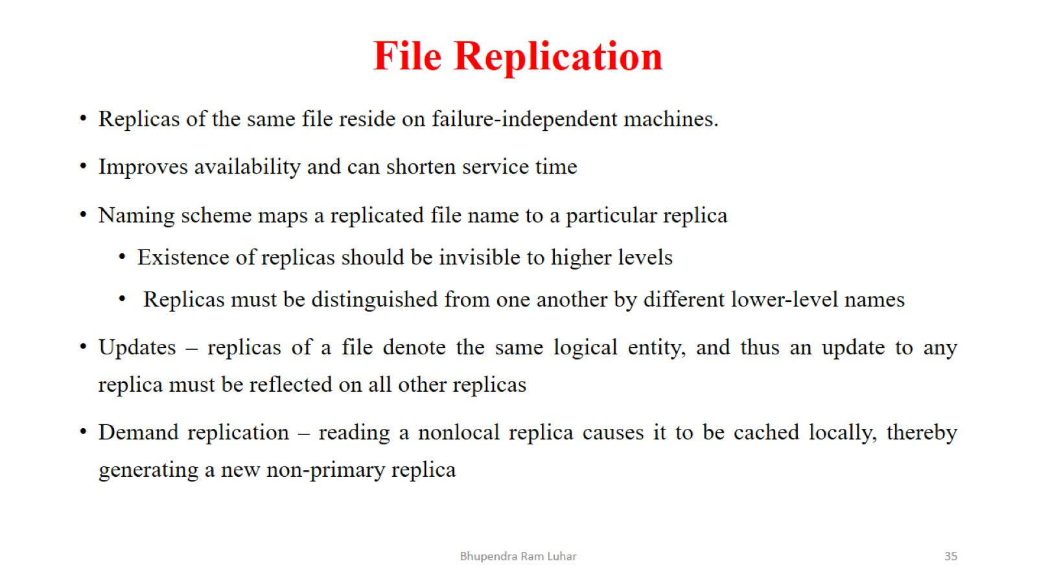
File Replication

Slide 36
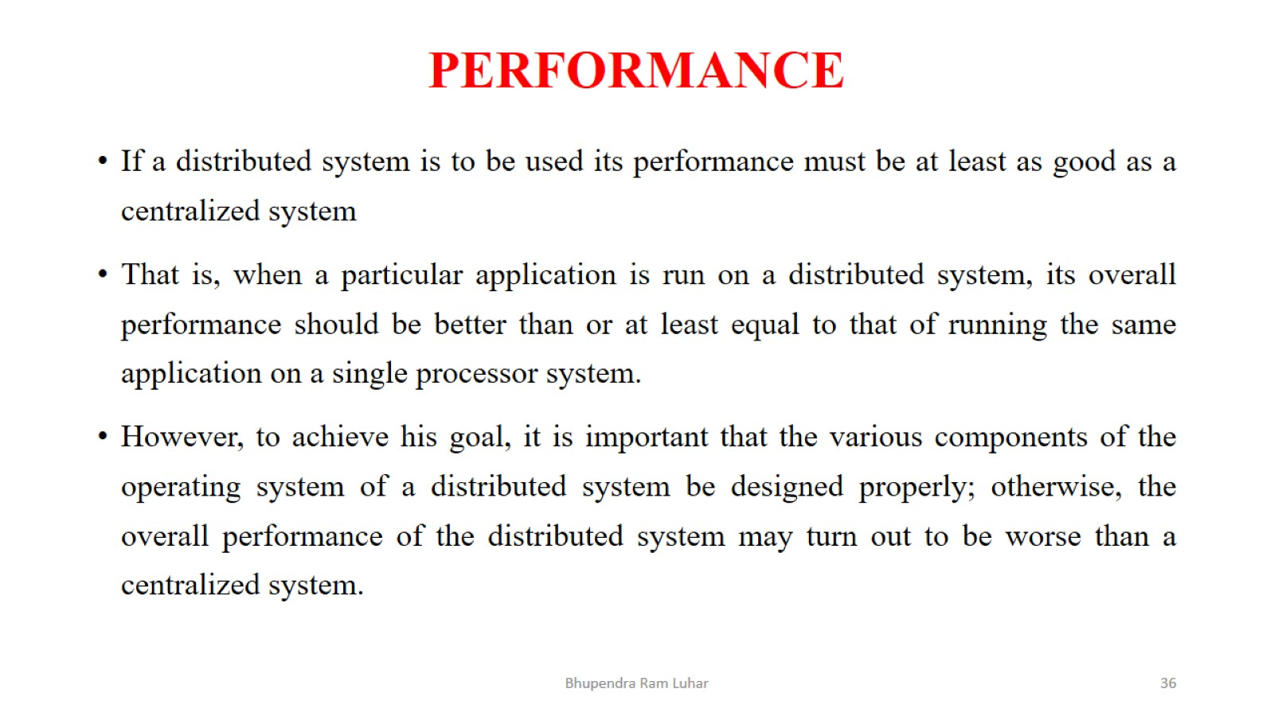
PERFORMANCE

Slide 37
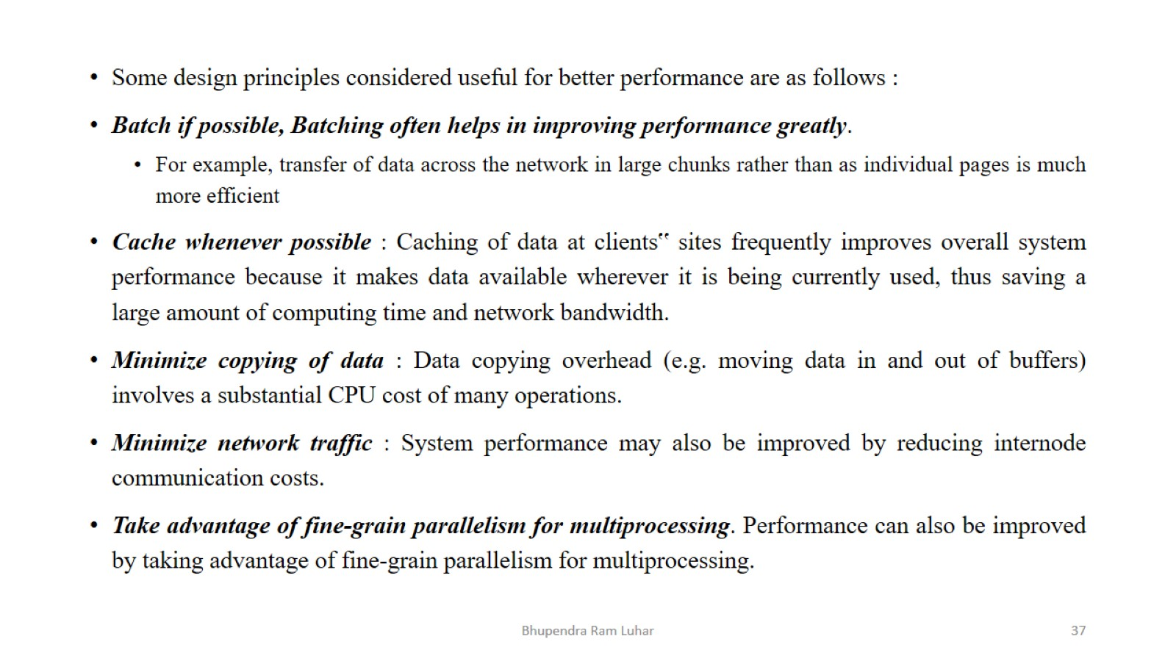

Slide 38
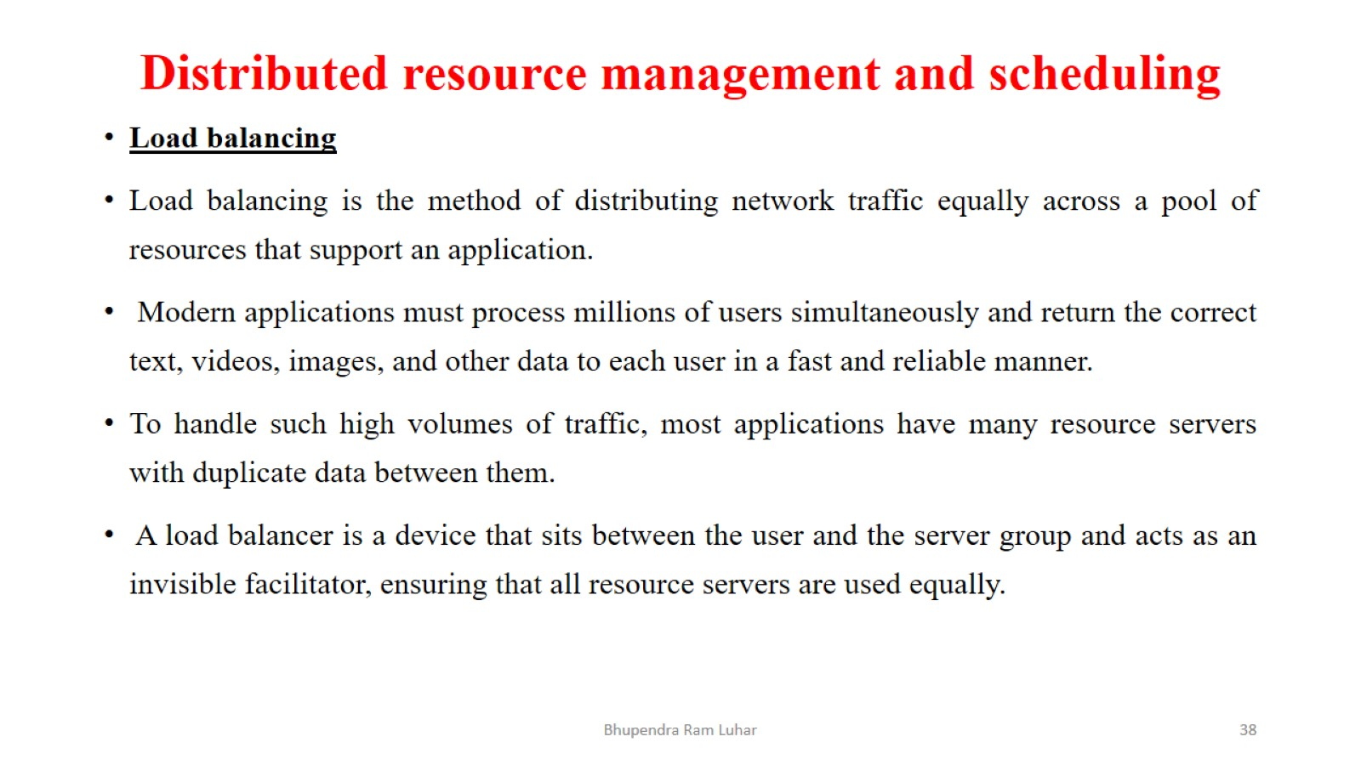
Distributed resource management and scheduling

Slide 39
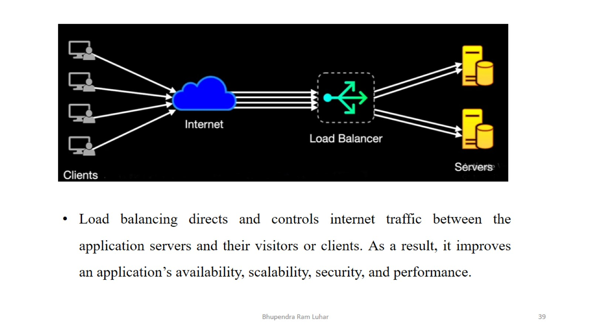

Slide 40
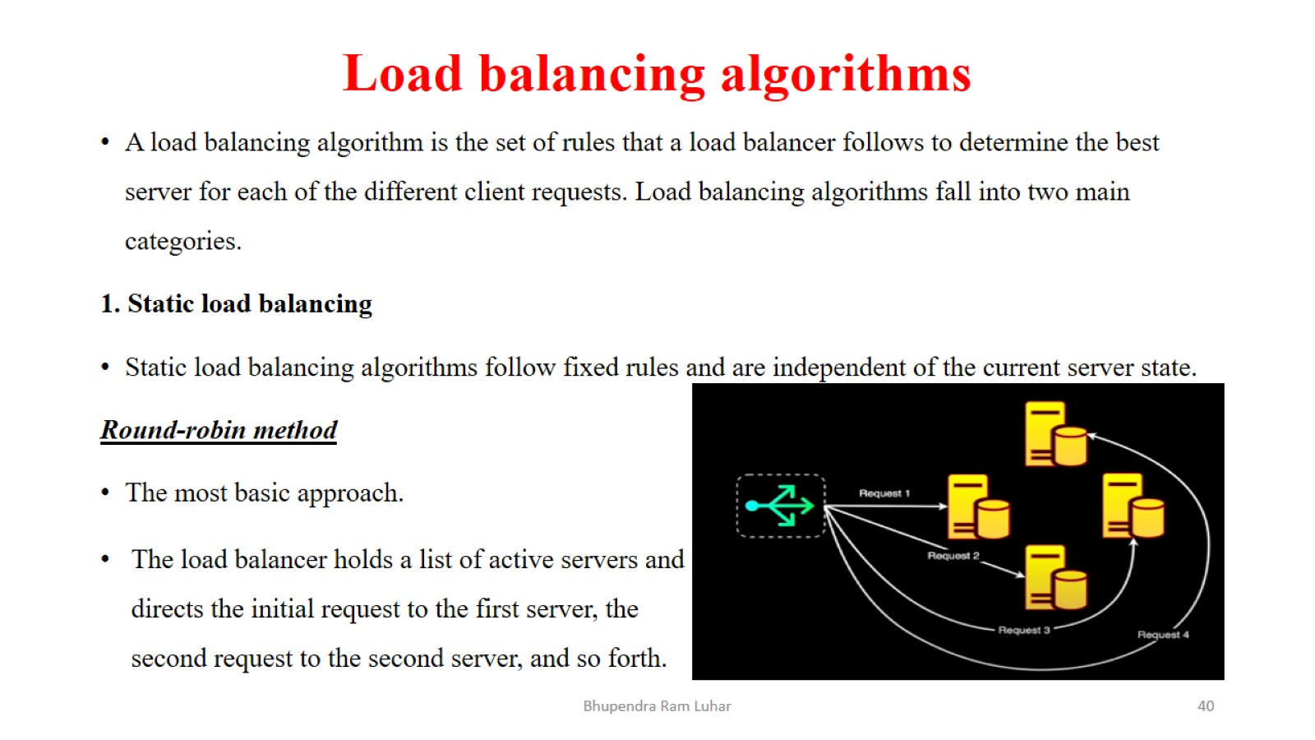
Load balancing algorithms

Slide 41
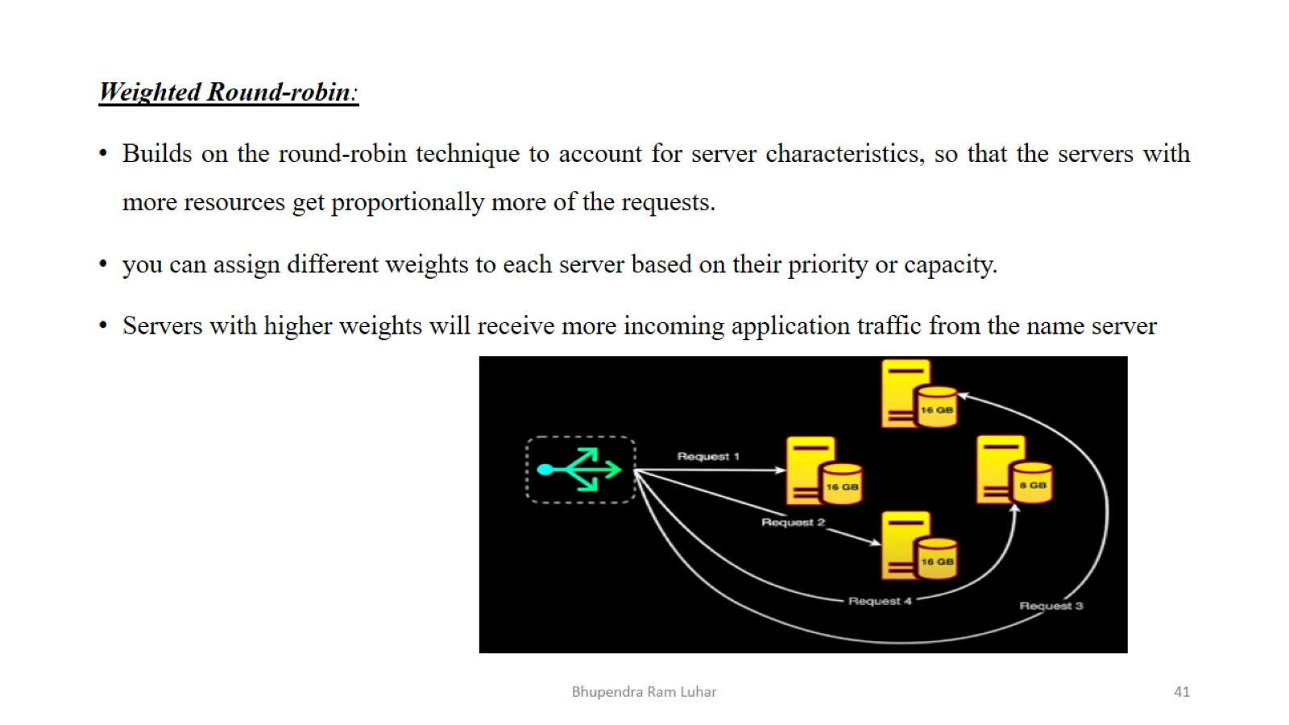

Slide 42
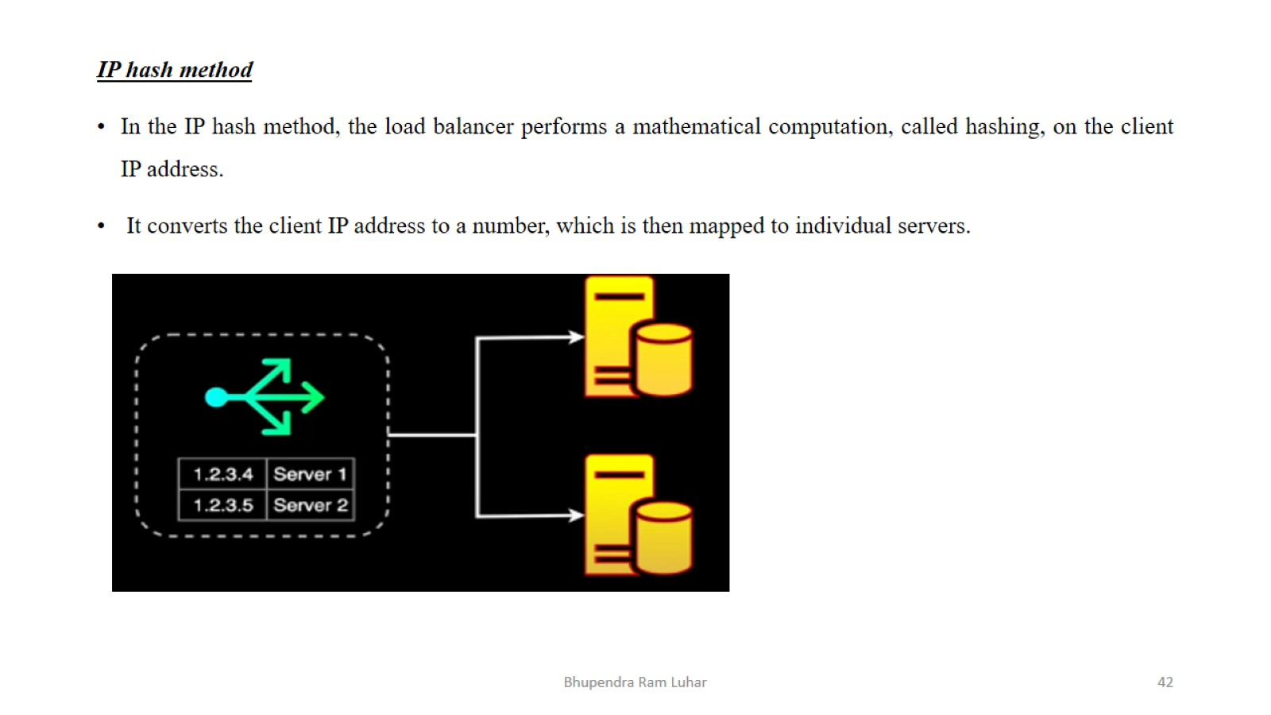

Slide 43
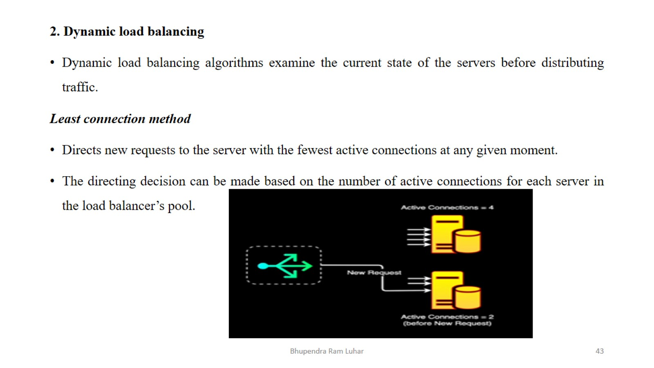

Slide 44
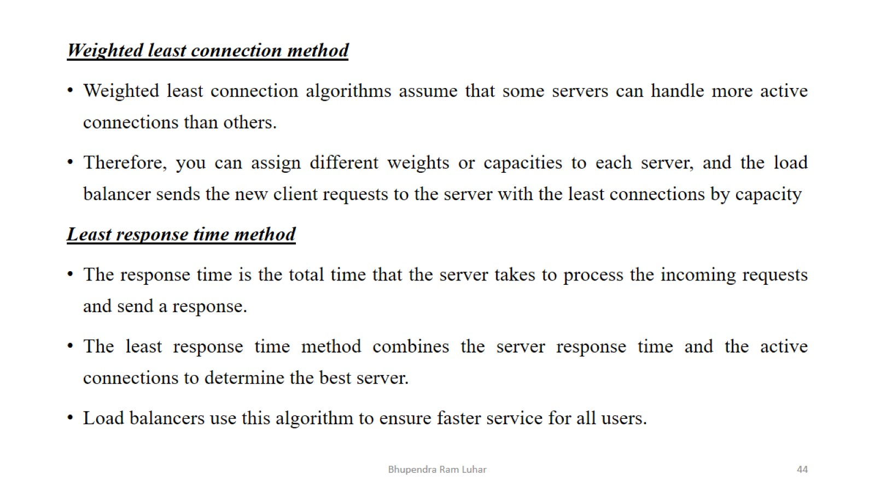

Slide 45
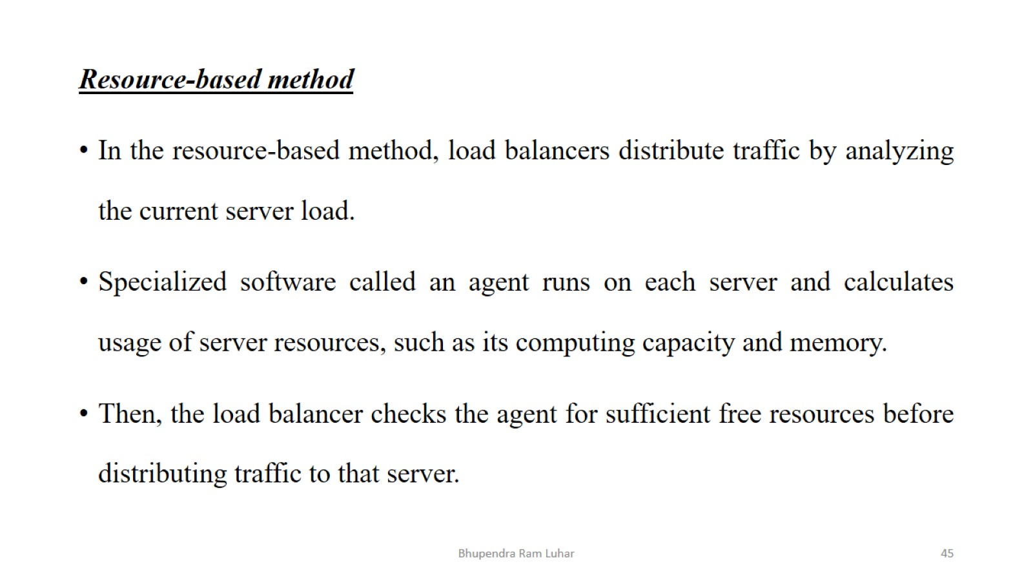

Slide 46
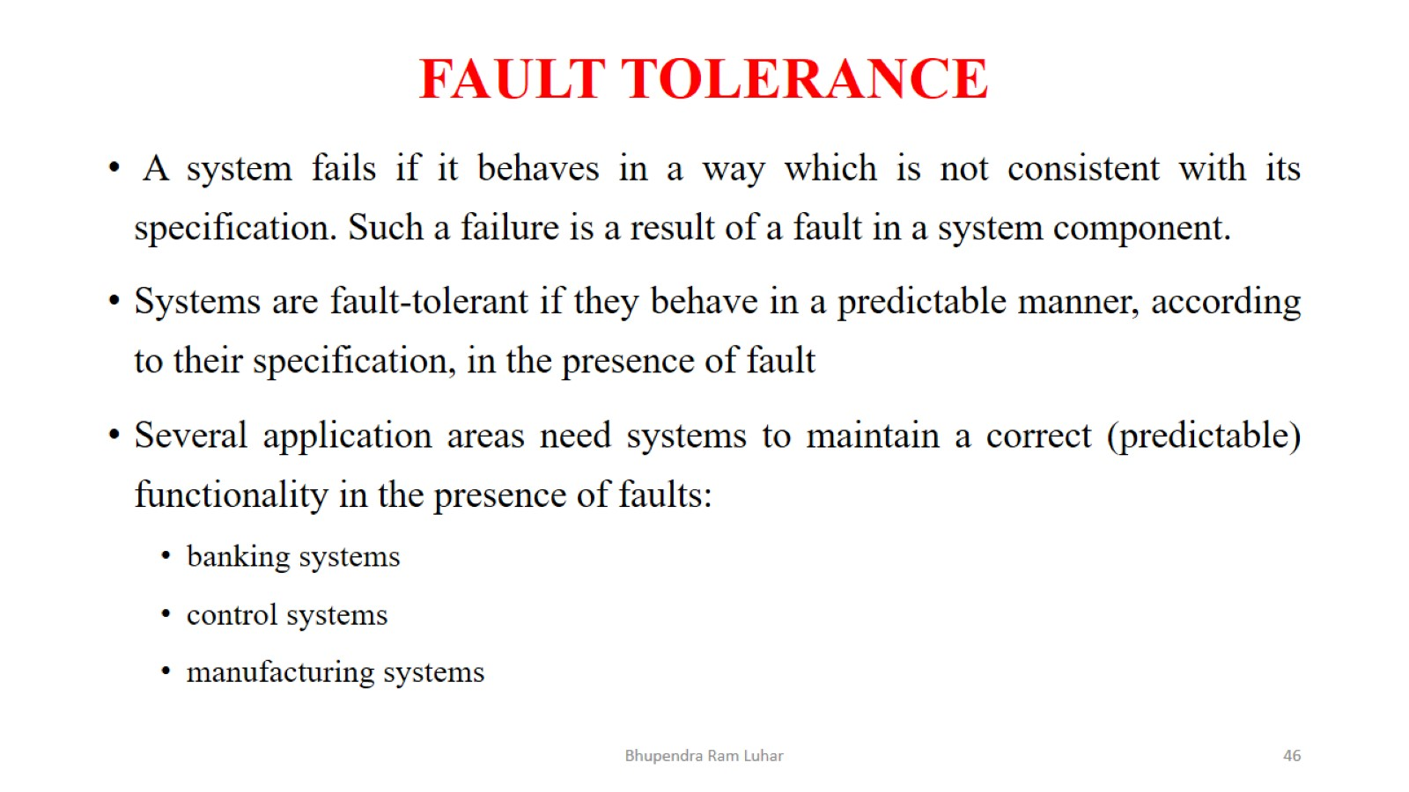
FAULT TOLERANCE

Slide 47
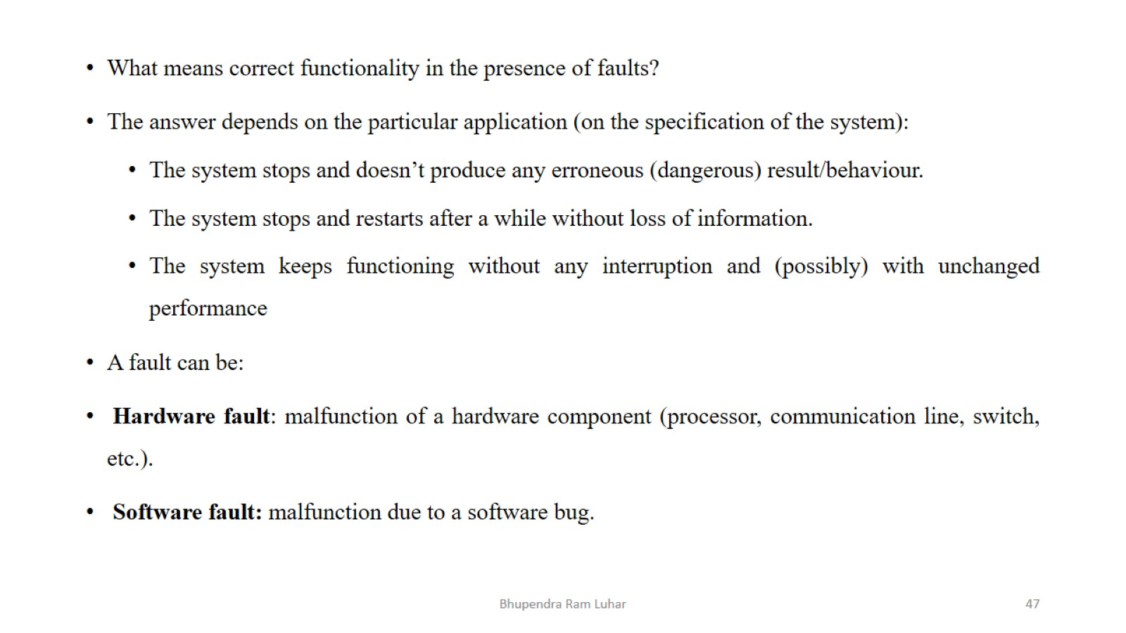

Slide 48
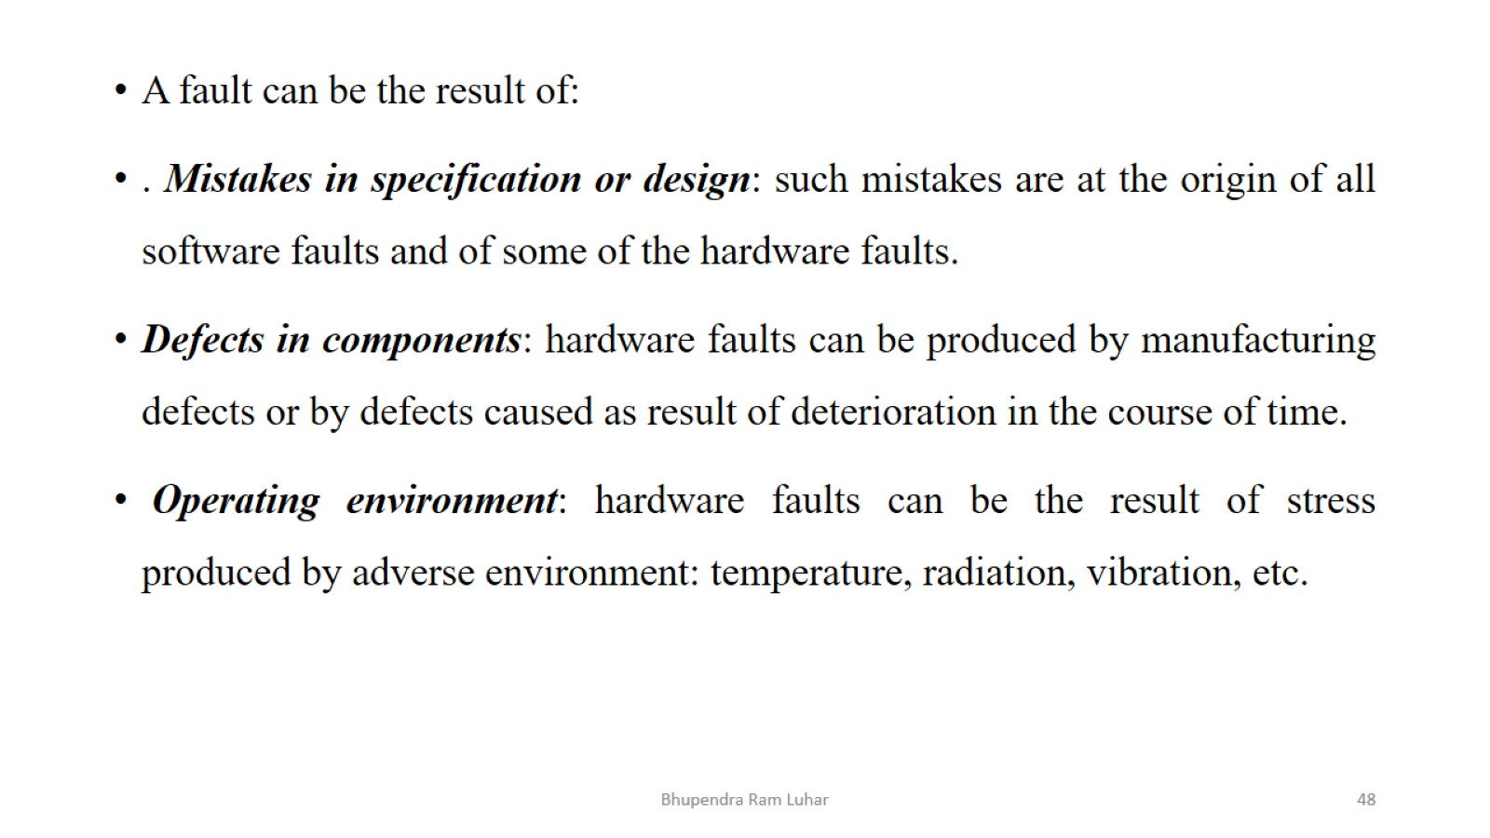

Slide 49
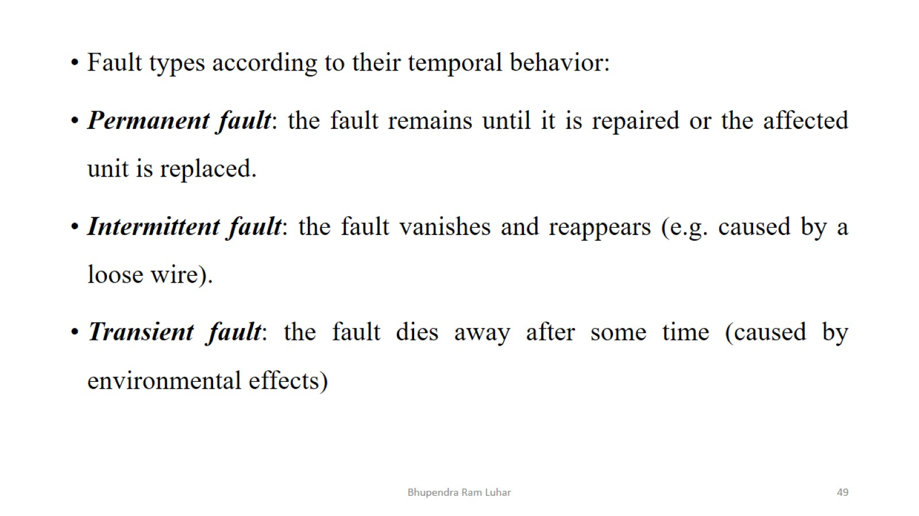

Slide 50
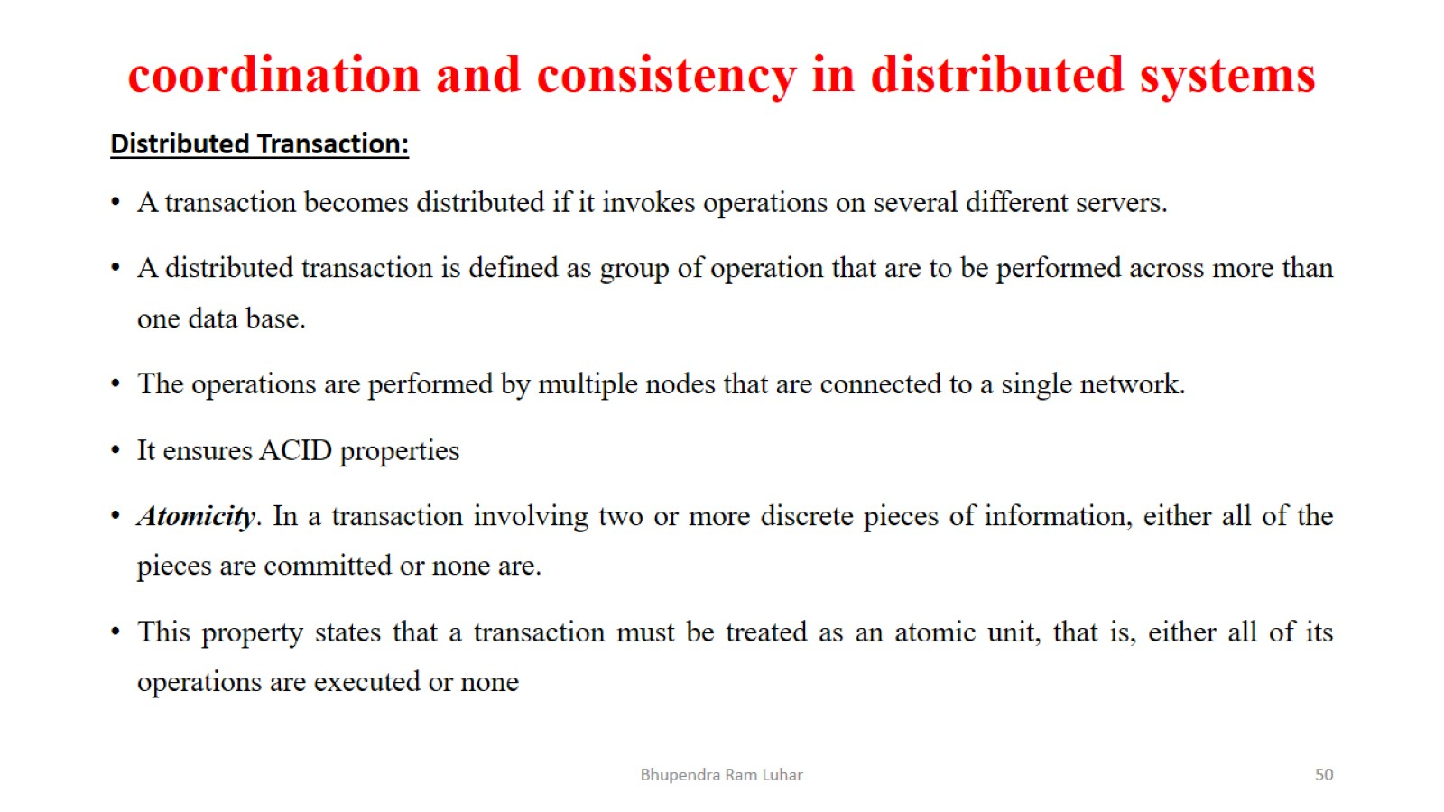
coordination and consistency in distributed systems

Slide 51


Slide 52

Type of Distributed Transaction

Slide 53

Type of Distributed Transaction

Slide 54

Concurrency Control

Slide 55

Concurrency Control

Slide 56


Slide 57


Slide 58

Concurrency Control Mechanism

Slide 59


Slide 60


Slide 61


Slide 62

Security and privacy in distributed systems

Slide 63


Slide 64


Slide 65


Slide 66

Advanced topics in distributed systems

Slide 67


Slide 68


Slide 69


Slide 70

Advanced topics in distributed systems

Slide 71


Slide 72


